Slide 1
Easy Access of NASA HDF data via OPeNDAP
Kent Yang and Joe Lee
The HDF Group
Notes:
Clarification of HDF-EOS website
The Earth Observing System Project Science Office -> eospso.gsfc.nasa.gov (Information about Earth Observing System)
SDP Toolkit/HDF-EOS: http://newsroom.gsfc.nasa.gov/sdptoolkit/toolkit.html
HDF Group website: http://hdfgroup.org
But HDF-EOS Tools and Information Center http://hdfeos.org or http://hdfeos.net
Don’t forget MLS. Highlight HDF4 handler.
Say problem: Java / CERES
Add Zhang Fan
Explain two reasons for this work:
We’ve done this work in the past few months.
Some information of tools are out of date. Need to be updated.
Requests for more information such as examples.

Slide 2

Easy
Notes:
The Earth Observing System Project Science Office -> eospso.gsfc.nasa.gov (Information about Earth Observing System)
SDP Toolkit/HDF-EOS: http://newsroom.gsfc.nasa.gov/sdptoolkit/toolkit.html
HDF Group website: http://hdfgroup.org
But HDF-EOS Tools and Information Center http://hdfeos.org or http://hdfeos.net Screenshot of http://hdfeos.org
Explain two reasons for this work:
We’ve done this work in the past few months.
Some information of tools are out of date. Need to be updated.
Requests for more information such as examples.

Slide 3
Outline
Introduction to OPeNDAP
HDF4/5-OPeNDAP Handlers
Live Demo
Notes:
For those who missed the OPeNDAP tutorial on the first day workshop, I’ll give a brief introduction to OPeNDAP again.
I’ll give a short update for HDF5 OPeNDAP handler work first and then HDF4 OPeNDAP handler wok, which was the major work of the last year.
At the end, I’ll go over the future work necessary for HDF4 handler.

Slide 4
OPeNDAP
A software framework that allows simple access to remote data
Client-server model
Servers make the local data accessible remotely
Clients make applications easily access to remote served data
Widely used by Earth Science Community
URL: http://www.opendap.org/

Slide 5
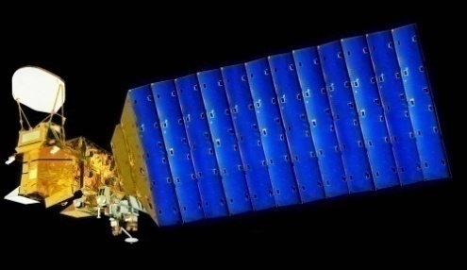
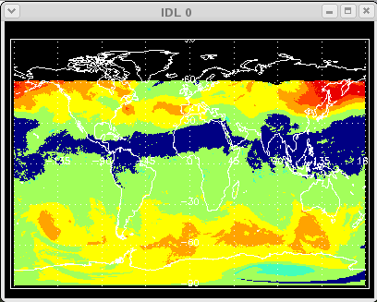

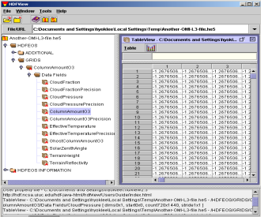
Access HDF via FTP
Aqua/Aura
Users
IDL
AIRS/OMI
FTP
Local HDF Files
FTP
Clients
FTP
Servers
HDF Files
Notes:
When it comes to the network access of data, people think of this manner.
OPeNDAP is an open implementation of easy data access through visualization tools like IDV.
Our work bridges the existing OPeNDAP framework and HDF so that visualization is possible over the Internet.

Slide 6

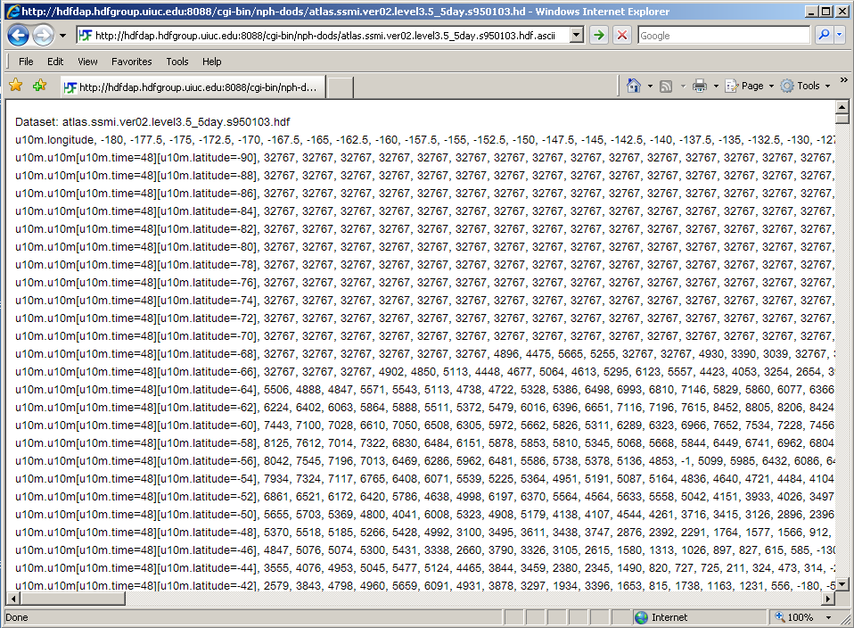
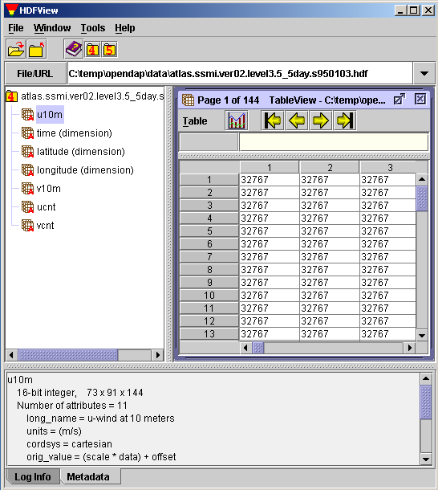
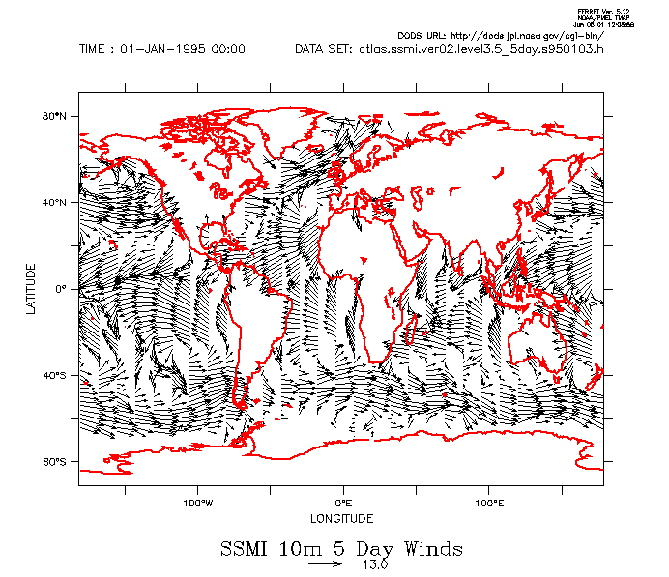
OPeNDAP Concept
Typical Remote Access
View Data
(User)
FTP/HTTP
Remote Data
(HDF4/5)
Visualization Tools
(gradsdap)
Visualization tools
(e.g., grads)
Handler
(hdf4/5_handler)
Client Library
(libnc_dap)
Server
(Hyrax)
Data Access Protocol (DAP) via Internet
Notes:
This is how remote data can be accessed via OPeNDAP. Normally, users can view local data file using scientific data using visualization tools like GrADS. In DAP, this can be done for remote file. First DAP provides both generic server and client. For different data format like HDF and NetCDF, it needs an additional server that can map such data into a standard DAP format.
Next, by modifying the existing visualization tools to adopt OPeNDAP client library, they can show the remote data on demand.
The benefit of OPeNDAP is clear when you want to view a small dataset; you don’t have to download the entire data from the server.
DAP is a low-level medium that implementers can impose any additional restrictions on top of DAP model.
The bottom line is that web browser can access any HDF data.

Slide 7

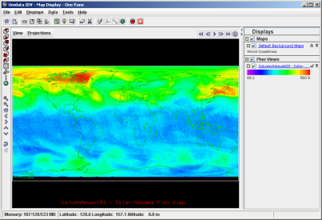
Access HDF via OPeNDAP
Aqua/Aura
Users
Hyrax
IDV
libnc-dap
HDF HANDLER
AIRS/OMI
DAP
Visualization
Tools
OPeNDAP
Clients
OPeNDAP
Servers
HDF Files
Notes:
For people who are not familiar with OPeNDAP, I’ll explain how OPeNDAP works with HDF.
OPeNDAP is an open implementation of easy data access through visualization tools like IDV.
Our work bridges the existing OPeNDAP framework and HDF so that visualization is possible over the Internet.

Slide 8
OPeNDAP Data Types
OPeNDAP provides three basic data objects:
  data descriptor structure (.dds)
  syntactic metadata – rigid
  data attribute structure (.das)
  semantic metadata – flexible
  data (.dods) - the actual data in a binary structure
Data are requested with a URL

Slide 9
OPeNDAP Servers
Flat
Binary
CODAR
netCDF
HDF4/5
Matlab
DSP
Tables
SQL
FITS
CDF
CEDAR
General
Data
Data
Data
Data
Data
Data
Data
Data
Data
Data
Data
Data
CODAR
netCDF
Matlab
JGOFS
FITS
FreeFrom
ESML
HDF4/5
DSP
JDBC
CDF
CEDAR

Slide 10
OPeNDAP Clients
Matlab
Client
IDL
Client
netCDF C
netCDF Java
Ferret
GrADS
IDV
VisAD
ncBrowse
Matlab
IDL
Access
Excel

Slide 11
Outline
Introduction to OPeNDAP
HDF4/5-OPeNDAP Handlers
Live Demo
Notes:
For those who missed the OPeNDAP tutorial on the first day workshop, I’ll give a brief introduction to OPeNDAP again.
I’ll give a short update for HDF5 OPeNDAP handler work first and then HDF4 OPeNDAP handler wok, which was the major work of the last year.
At the end, I’ll go over the future work necessary for HDF4 handler.

Slide 12
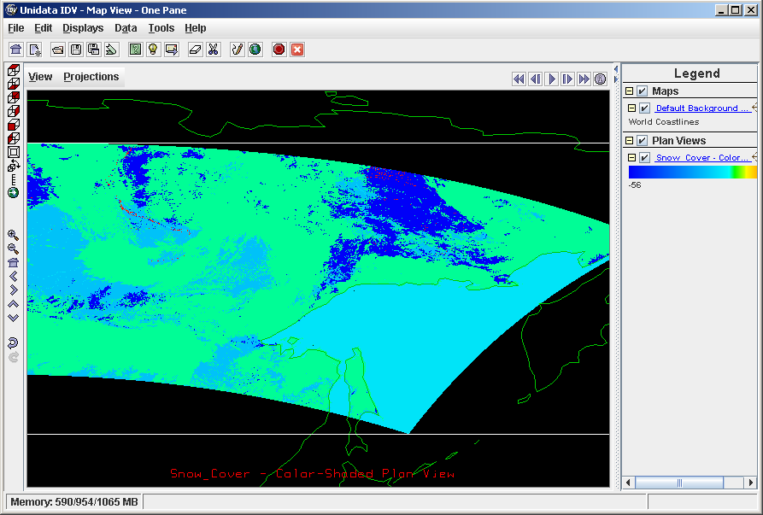

Enhanced HDF4 Handler
Enhanced HDF4 HANDLER
Aura
Users
MODIS Swath
w/ Dim. Map
IDV
libnc-dap
Hyrax
DAP
Visualization
Tools
OPeNDAP
Clients
OPeNDAP
Servers
HDF4 Files
Notes:
I will quickly go over hdf5 handler update.
First, I’ll describe the problems of the old handlers and then what we did, limitations of our solution and future work.
HE2 to EOS2.

Slide 13
An example: Access HDF data via OPeNDAP
Swath with Dimension Map
Notes:
Here’s one proof that using HDF-EOS2 library really helps to visualize something that wasn’t possible with a parser-based solution.

Slide 14
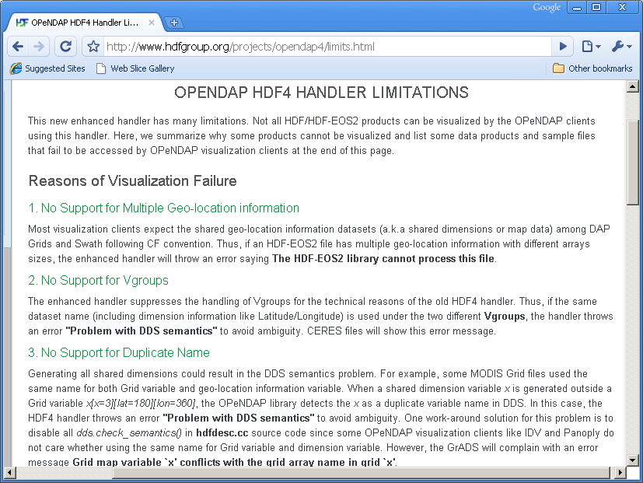
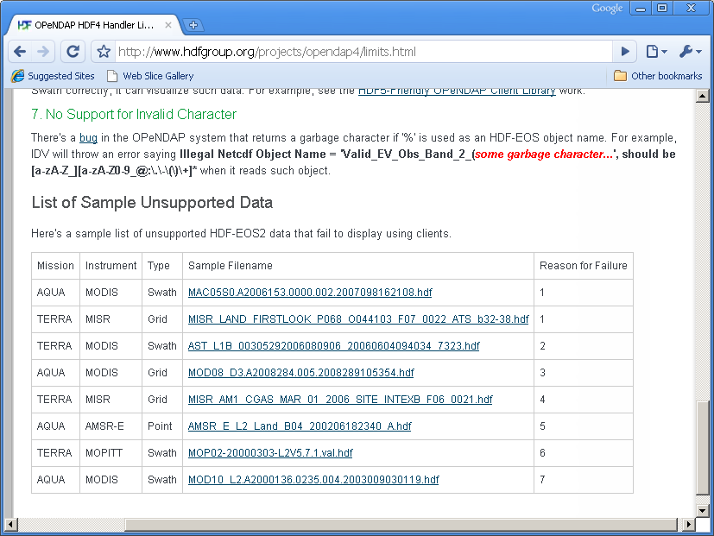
HDF-EOS2 Products Supported
GES DISC
  AIRS / MERRA / TOMS
LAADS / LP DAAC / NSIDC
  Many MODIS products
NSIDC
  AMSR_E / NISE
LaRC
  MISR / MOPITT / some CERES(TRMM)
Notes:
We have summarized the top 7 reasons why some HDF-EOS will fail.
We also listed some sample files that will not work with HDF4 handler.
Here are screenshots of website.
Make animation – screen shots in between texts.

Slide 15
Pure HDF4 Products Supported
GES DISC
  TRMM L1B, L2B Swath
  TRMM L3 Grid 42B & 43B products
OBPG (Ocean Color)
  SeaWiFS / MODIST / MODISA
  CZCS / OCTS
Notes:
We have summarized the top 7 reasons why some HDF-EOS will fail.
We also listed some sample files that will not work with HDF4 handler.
Here are screenshots of website.
Make animation – screen shots in between texts.

Slide 16
Pure HDF4 Products Supported
CERES
  CER_AVG
  CER_ES4
  CER_ISCCP-D2like-Day
  CER_ISCCP-D2like-GEO
  CER_SRBAVG
  CER_SYN
  CER_ZAVG
Notes:
We have summarized the top 7 reasons why some HDF-EOS will fail.
We also listed some sample files that will not work with HDF4 handler.
Here are screenshots of website.
Make animation – screen shots in between texts.

Slide 17
Limitations
Reasons for Visualization Failures
  IDV / Panoply / Java Heap Memory
  Network / DAP (e.g., max HTTP header size)
  Can’t retrieve key information correctly (e.g., LAMAZ projection) from data
  Unable to harmonize with CF-conventions (e.g., FillValue inside latitude and longitude)
Notes:
We have summarized the top 7 reasons why some HDF-EOS will fail.
We also listed some sample files that will not work with HDF4 handler.
Here are screenshots of website.
Make animation – screen shots in between texts.

Slide 18
Limitations(continued)
HDF-EOS2 + additional HDF4 objects
  Additional HDF4 objects will be ignored.
The rest of pure HDF4 products not listed in previous slides are not tested and may not be visualized by Java OPeNDAP Clients.
Notes:
We have summarized the top 7 reasons why some HDF-EOS will fail.
We also listed some sample files that will not work with HDF4 handler.
Here are screenshots of website.
Make animation – screen shots in between texts.

Slide 19
HDF-EOS5 products Supported
OMI Swath, Grid
MLS/HIRDLS Swath
TES Grid

Slide 20
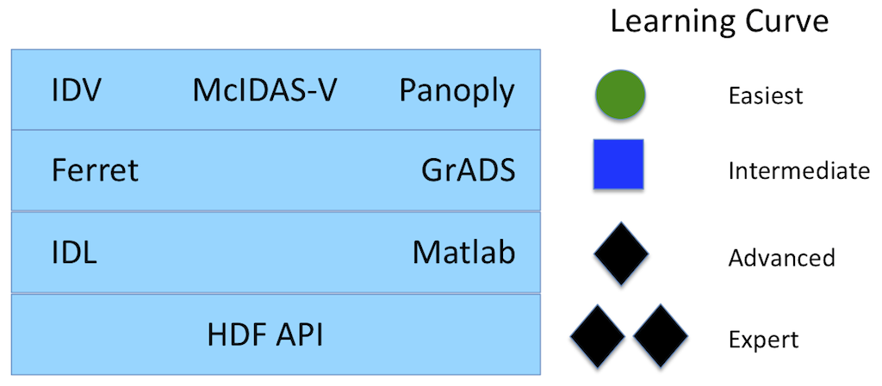
Learning Curve of accessing HDF data
NCL
From the ESIP wiki page:
http://wiki.esipfed.org/index.php/Making_Science_Data_Easier_to_Use_with_OPeNDAP
Making Science Data Easier to Use with OPeNDAP

Slide 21
Live Demo
Notes:
IDV Examples from hdfeos.org.
Demo server from hdfgroup.org.

Slide 22
OPeNDAP HDF4/HDF5 handlers
Source codes and RPMs can be found under
http://opendap.org
Demo HDF5/HDF4 servers
http://hdfeos.org/zoo/hdf5_handler/
http://hdfeos.org/zoo/hdf5_handler/
Currently NASA GES DISC has installed both OPeNDAP HDF4 and HDF5 handlers
Notes:
We have summarized the top 7 reasons why some HDF-EOS will fail.
We also listed some sample files that will not work with HDF4 handler.
Here are screenshots of website.
Make animation – screen shots in between texts.

Slide 23
Thank you !

Slide 24
Acknowledgements
This work was supported by cooperative agreement number NNX08AO77A from the National Aeronautics and Space Administration (NASA).
Any opinions, findings, conclusions, or recommendations expressed in this material are those of the author[s] and do not necessarily reflect the views of the National Aeronautics and Space Administration.

Slide 25
Questions/comments?

Slide 26
Our Work
Let Visualization Clients Access HDF-EOS2 and HDF4 files
Notes:
Therefore, our primary goal is to enhance it so that it can visualize data instantly.

Slide 27
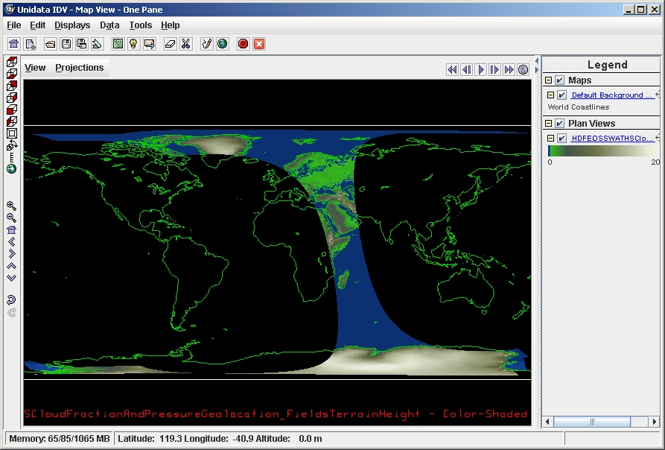
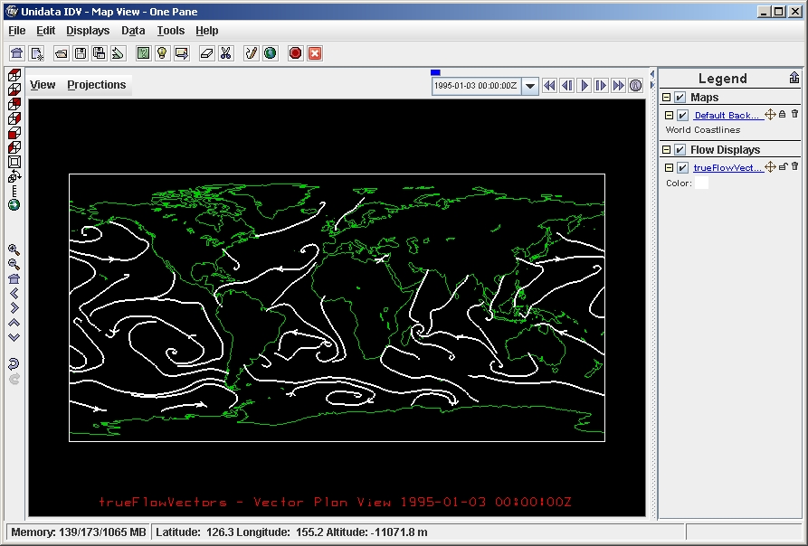
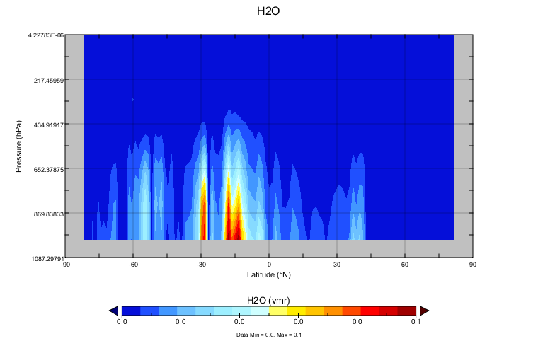
HDF5-OPeNDAP Handler Update
Support Aura HDF-EOS5 OMI Swath
Access some files that follow HDF5 Dimension Scale Specification
Support Aura HDF-EOS5 MLS
Notes:
For HDF5 handler, we added support for some OMI swath file.
Next, we added a support for some files that follow HDF5 dimension scale models.
Finally, we changed short name option. This helps GrADs users to visualize data more quickly using the simple ‘sdfopen’ command.

