Slide 1
Easy Access of HDF data via NCL/IDL/MATLAB
Kent Yang, Tong Qi, Ziying Li, Yi Wang, Shu Zhang, Joe Lee
The HDF Group
ESIP 2010
July 22, 2010
Notes:
Common concepts of getting the data and visualizing the data
Explain two reasons for this work:
We’ve done this work in the past few months.
Some information of tools are out of date. Need to be updated.
Requests for more information such as examples.
Get the feedback often.

Slide 2
Motivation
Many Heterogeneous NASA HDF data products
To visualize the data, different products need to be handled differently
Users need to spend extra time figuring out the solutions
Individual data centers have already provided data services for the data they distributed
Some end-users prefer to use their favorite tools to access HDF data

Slide 3
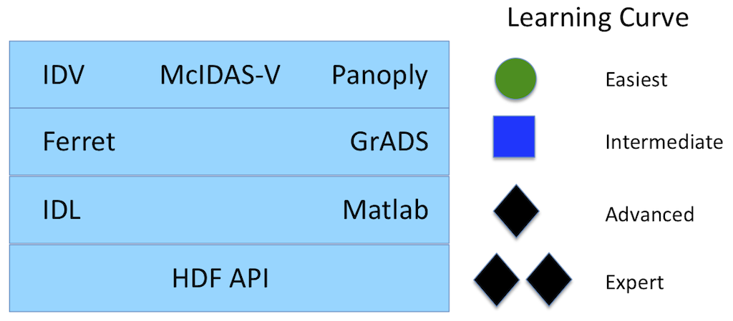
Learning Curve of accessing HDF data
NCL
From the ESIP wiki page:
http://wiki.esipfed.org/index.php/Making_Science_Data_Easier_to_Use_with_OPeNDAP
Making Science Data Easier to Use with OPeNDAP

Slide 4

Motivation
Notes:
The Earth Observing System Project Science Office -> eospso.gsfc.nasa.gov (Information about Earth Observing System)
SDP Toolkit/HDF-EOS: http://newsroom.gsfc.nasa.gov/sdptoolkit/toolkit.html
HDF Group website: http://hdfgroup.org
But HDF-EOS Tools and Information Center http://hdfeos.org or http://hdfeos.net Screenshot of http://hdfeos.org
Explain two reasons for this work:
We’ve done this work in the past few months.
Some information of tools are out of date. Need to be updated.
Requests for more information such as examples.

Slide 5

How?

Slide 6
Basic Examples

Slide 7
Introduction to NCL/IDL/MATLAB
Interpreted languages
Visualization, analysis and computation
NCL
- Free package, developed by NCAR
- Support HDF-EOS2, HDF-EOS5 and HDF4
IDL
- Widely used by Earth Science Community
- Support HDF-EOS2, HDF4 and HDF5
MATLAB
- Widely used by Computation and Engineering Communities
- Support HDF-EOS2, HDF4 and HDF5
Notes:
developed by the CISL at NCAR. It is an interpreted language designed for visualization and analysis of scientific data.

Slide 8
A simple NCL example
load "$NCARG_ROOT/lib/ncarg/nclex/gsun/gsn_code.ncl"
load "$NCARG_ROOT/lib/ncarg/nclscripts/csm/gsn_csm.ncl"
begin
cdf_file = addfile("AMSR_E_L3_RainGrid_B05_200707.he2","r")
rrland = cdf_file->RrLandRain_MonthlyRainTotal_GeoGrid(:,:)
rrland@_FillValue = -1
resources = True
xwks = gsn_open_wks("pdf","AE_RnGd.hdfeos2")
plot = gsn_csm_contour_map_ce(xwks,rrland,resources)
end

Slide 9
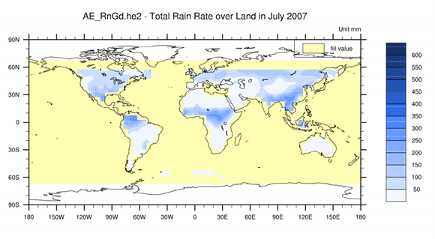
Complete Code can be found under
http://hdfeos.org/software/ncl.php#ref_sec:ncl-hdf-eos2-grid-1d-unabridged

Slide 10
A simple IDL example
PRO AMSR_E_L2A_BrightnessTemperatures
FILE_NAME=
"AMSR_E_L2A_BrightnessTemperatures_V09_200206190029_D.hdf“
SWATH_NAME='Low_Res_Swath'
DATAFIELD_NAME='23.8H_Approx._Res.3_TB_(not-resampled)'
file_id = EOS_SW_OPEN(FILE_NAME)
swath_id = EOS_SW_ATTACH(file_id, SWATH_NAME)
status = EOS_SW_READFIELD(swath_id, DATAFIELD_NAME, data)
status = EOS_SW_READFIELD(swath_id, 'Longitude', lon)
status = EOS_SW_READFIELD(swath_id, 'Latitude', lat)
status = EOS_SW_DETACH(swath_id)
status = EOS_SW_CLOSE(file_id)
MAP_SET, /GRID, /CONTINENTS
CONTOUR, data, lon, lat, /OVERPLOT, NLEVELS=20, /CELL_FILL
END

Slide 11
A simple MATLAB example
FILE_NAME='AMSR_E_L2A.hdf'
SWATH_NAME='Low_Res_Swath‘
file_id = hdfsw('open', FILE_NAME, 'rdonly')
swath_id = hdfsw('attach', file_id, SWATH_NAME)
DATAFIELD_NAME='23.8H_Approx._Res.3_TB_(not-resampled)'
[data, fail] = hdfsw('readfield', swath_id, DATAFIELD_NAME, [], [], [])
[lon, status] = hdfsw('readfield', swath_id, 'Longitude', [], [], [])
[lat, status] = hdfsw('readfield', swath_id, 'Latitude', [], [], [])
hdfsw('detach', swath_id);
hdfsw('close', file_id);
contourf(lon,lat,data);

Slide 12
More information on the descriptions of these examples
Check hdfeos.org
NCL: http://hdfeos.org/software/ncl.php
IDL: http://hdfeos.org/examples/idl.php
MATLAB: http://hdfeos.org/examples/matlab.php

Slide 13
Motivation
Notes:
The Earth Observing System Project Science Office -> eospso.gsfc.nasa.gov (Information about Earth Observing System)
SDP Toolkit/HDF-EOS: http://newsroom.gsfc.nasa.gov/sdptoolkit/toolkit.html
HDF Group website: http://hdfgroup.org
But HDF-EOS Tools and Information Center http://hdfeos.org or http://hdfeos.net Screenshot of http://hdfeos.org
Explain two reasons for this work:
We’ve done this work in the past few months.
Some information of tools are out of date. Need to be updated.
Requests for more information such as examples.

Slide 14
More helpful
A comprehensive NCL/IDL/MATLAB example codes and plots for sample data from most NASA Data centers:
GES DISC
MODAPS(LAADS)
NSIDC
LP-DAAC
P.O DAAC
GHRC
OBPG(Ocean Color)
LaRC
Notes:
I want to say “Same thing for MATLAB IDL NCL” .
Breadth of coverage. Plots and codes.
Don’t give any favor on one tool.
Technical details - Special problems – performance problem / missing geo-info / scale – offset (get the data right)
Put the URL on every slide.

Slide 15
Where are these examples located?
http://hdfeos.org/zoo/
We welcome you to send us feedback on these examples. You can use the HDF-EOS forum(http://hdfeos.org/forums) to share your comments or contact us at eoshelp@hdfgroup.org .

Slide 16
Common Issues for Tools
MATLAB and IDL
- IDL
- For IDL 7.x and before, cannot add color bar by using scripts
- MATLAB
- For data array > 1MB, one needs to use 64-bit MATLAB to generate plots;
Takes very long time.

Slide 17
Common Issues for Tools
MATLAB and IDL
- HDF-EOS2 non-geographic projection Grids
- Need to provide additional latitude and longitude files
- HDF-EOS2 geographic projection Grids
- Need to obtain parameters to calculate latitude and longitude
All Tools
- HDF-EOS2 Swaths with dimension maps
- Need to provide additional latitude and longitude files

Slide 18
Other Issues
Different ways to store metadata in an HDF file
- Some HDF4 products don’t provide lat/lon
- Some HDF4 products provide attributes to calculate lat/lon
Users not familiar with HDF4 and HDF-EOS2 file structures

Slide 19
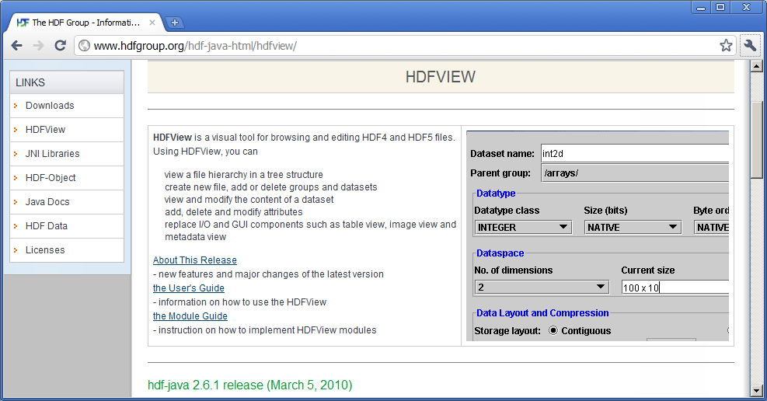
A Tip that you need to remember
You can always use HDFView to quickly examine any HDF files.

Slide 21
Now we will walk through examples for each NASA data center

Slide 22
GES DISC

Slide 23
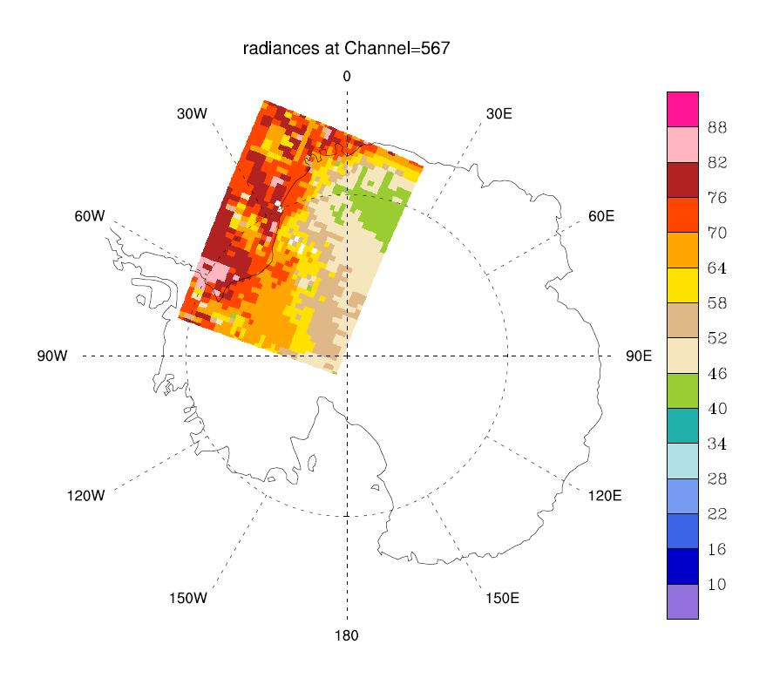
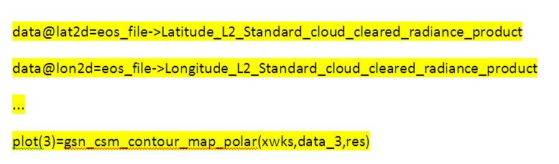
GES DISC AIRS Swath
Directly read the lat/lon and use the polar view
…
data=eos_file->radiances_L2_Standard_cloud_cleared_radiance_product(:,:,0) ; read specific subset of data field
; In order to read the radiances data field from the HDF-EOS2 file, the group
; under which the data field is placed must be appended to the data field in NCL. For more information,
; visit section 4.3.2 of http://hdfeos.org/software/ncl.php.
data@lat2d=eos_file->Latitude_L2_Standard_cloud_cleared_radiance_product ; associate longitude and latitude
data@lon2d=eos_file->Longitude_L2_Standard_cloud_cleared_radiance_product
data@_FillValue=-9999 ;
…
res@gsnCenterString="radiances at Channel=567"
plot(2)=gsn_csm_contour_map_polar(xwks,data_2,res)
res@gsnCenterString="radiances at Channel=1339"
plot(3)=gsn_csm_contour_map_polar(xwks,data_3,res)
delete(plot) ; cleaning up resources used
delete(data)
NCL
Notes:
In general, for all the following slides: You need to specify the tool name under the plot. The font should not be too small.
Add another code section:
Amplify
data@lat2d=eos_file->Latitude_L2_Standard_cloud_cleared_radiance_product
..
Amplify:
plot(3)=gsn_csm_contour_map_polar(xwks,data_3,res…)
Replace the plot with channel 567

Slide 24
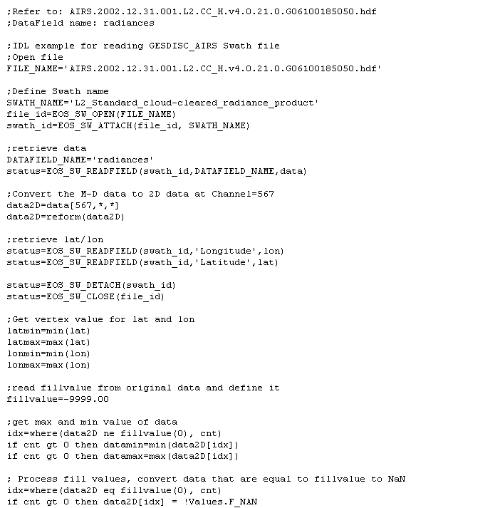
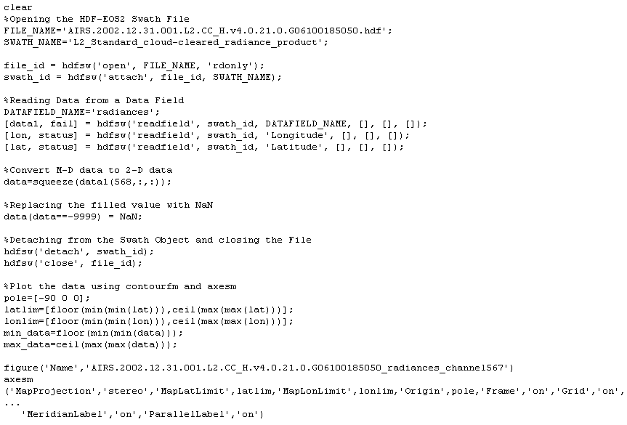
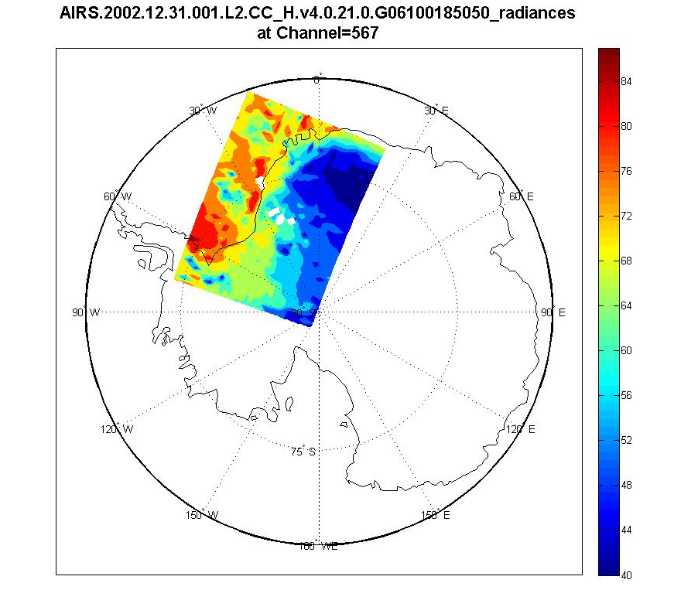
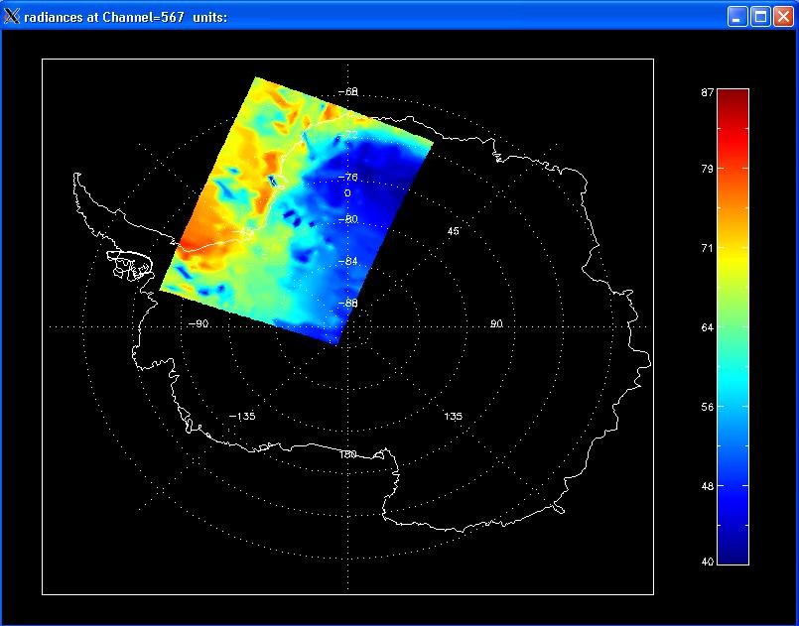
GES DISC AIRS Swath
IDL
Matlab
Notes:
Plots will fly in

Slide 25
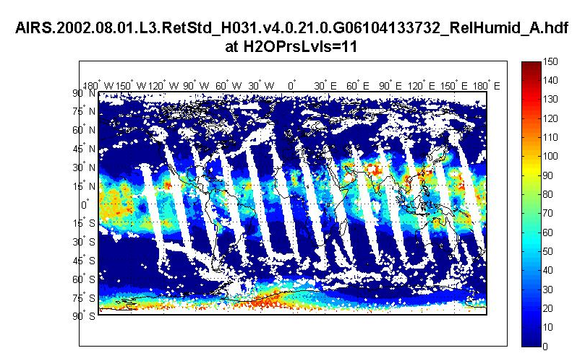
GES DISC AIRS Grid
A typical global grid. Lat. and Lon. are provided.
…
%Reading Data from a Data Field
GRID_NAME='ascending';
grid_id = hdfgd('attach', file_id, GRID_NAME);
DATAFIELD_NAME='RelHumid_A';
[data1, fail] = hdfgd('readfield', grid_id, DATAFIELD_NAME, [], [], []);
…
%Reading Lat and Lon Data
GRID_NAME='location';
grid_id = hdfgd('attach', file_id, GRID_NAME);
%Reading Lat Data
DATAFIELD_NAME='Latitude';
[lat, status] = hdfgd('readfield', grid_id, DATAFIELD_NAME, [], [], []);
lat=double(lat);
[fillvalue,status] = hdfgd('getfillvalue',grid_id, DATAFIELD_NAME);
lat(lat==fillvalue) = NaN;
%Reading Lon Data
DATAFIELD_NAME='Longitude';
[lon, status] = hdfgd('readfield', grid_id, DATAFIELD_NAME, [], [], []);
lon=double(lon);
[fillvalue,status] = hdfgd('getfillvalue',grid_id, DATAFIELD_NAME);
lon(lon==fillvalue) = NaN;
…
Matlab

Slide 26
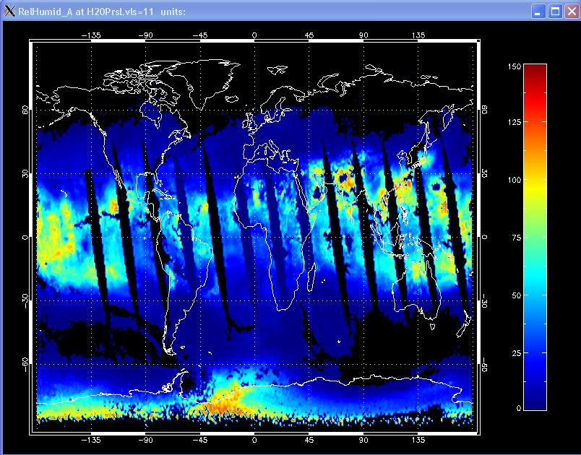
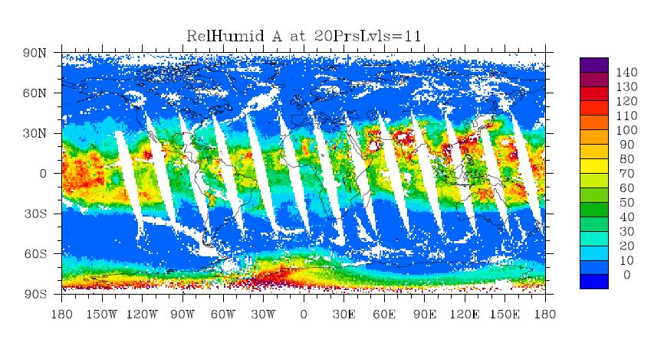
GES DISC AIRS Grid
NCL
IDL

Slide 27
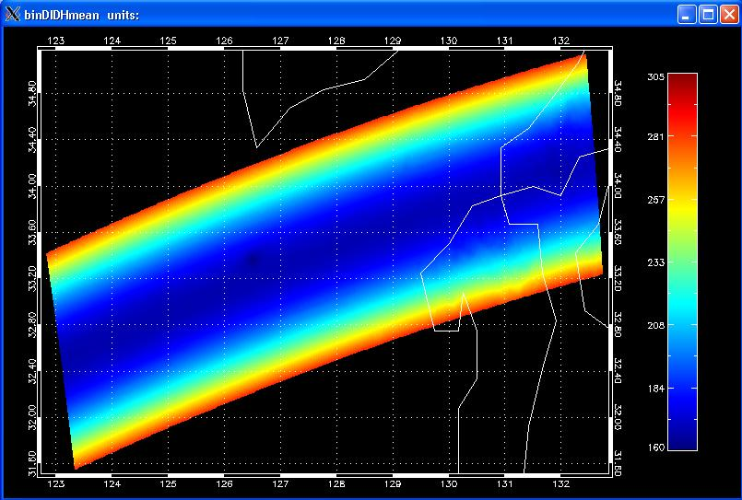
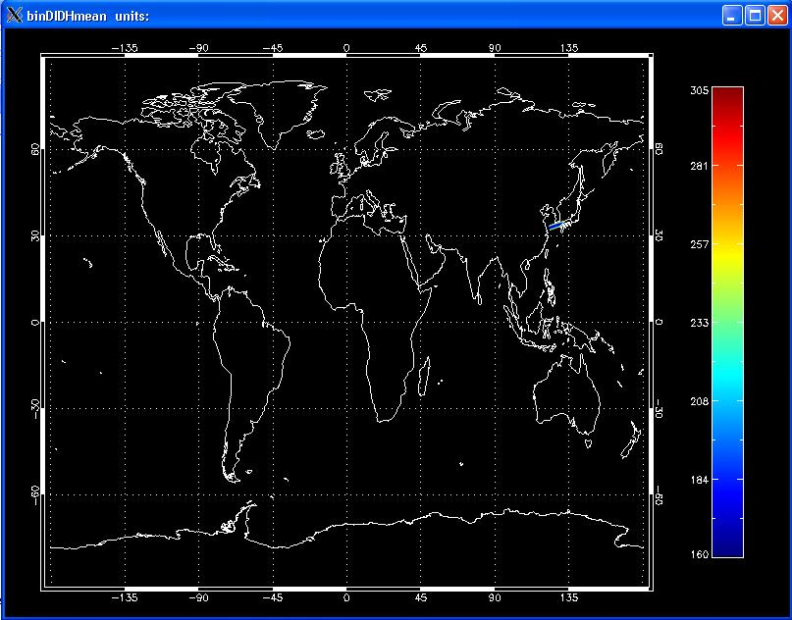
GES DISC TRMM Swath
The global view doesn’t show much information; need a zoom view.
1B21_CSI.990906.10217.KORA.6_binDIDHmean.idl
Notes:
Add a zoom view

Slide 28
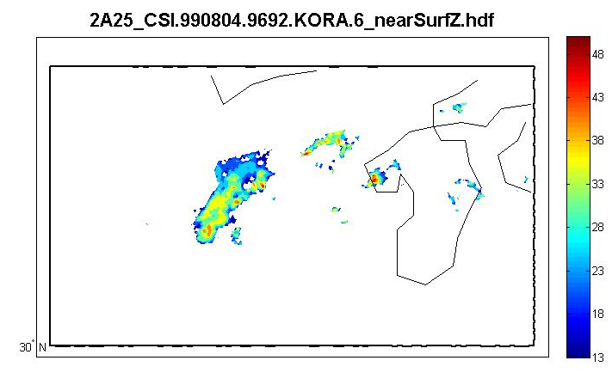
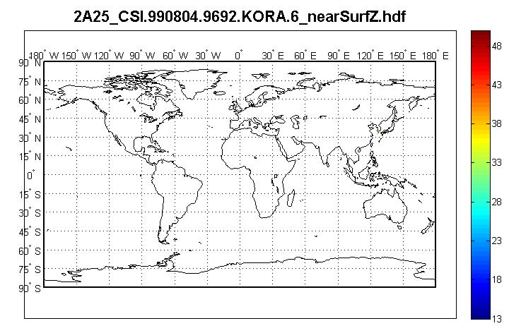
GES DISC TRMM Swath
Matlab

Slide 29
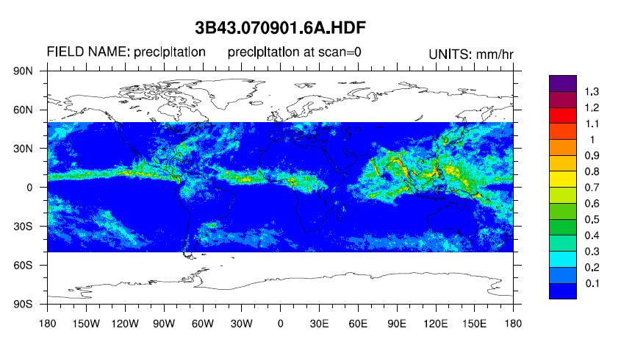
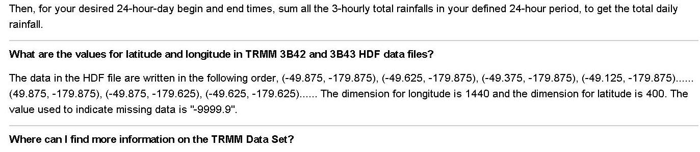
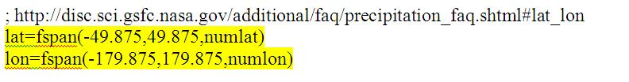
GES DISC TRMM Grid
Grid, 3B43:
Calculate lat/lon based on the formula
Add “units”
http://disc.sci.gsfc.nasa.gov/additional/faq/precipitation_faq.shtml#lat_lon
NCL
Notes:
Add a code section for calculating the lat/lon.

Slide 30
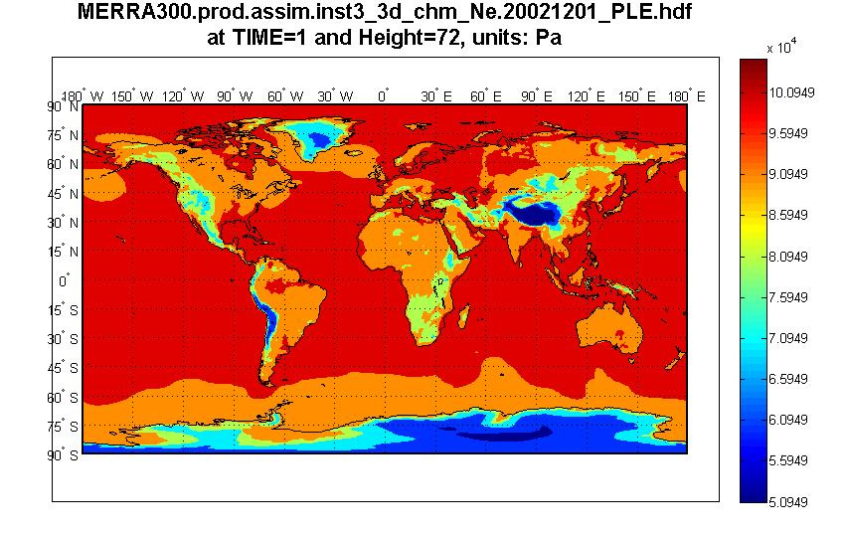
GES DISC MERRA Grid
A typical global grid
…
data=eos_file->PLE_EOSGRID(1,72,:,:) ; read specific subset of data field
;
; In order to read the PLE data field from the HDF-EOS2 file, the group
; under which the data field is placed must be appended to the data field in NCL. For more information,
; visit section 4.3.2 of http://hdfeos.org/software/ncl.php.
data@lon1d=eos_file->XDim_EOSGRID ; associate longitude and latitude
data@lat1d=eos_file->YDim_EOSGRID ; here, since the XDim/YDim arrays are 1-D, we use lon1d instead of lon2d
data@units="Pa"
data@long_name="Edge pressures"
…
data_4=eos_file->PLE_EOSGRID(7,70,:,:) ; read specific subset of data field
data_4@lon1d=eos_file->XDim_EOSGRID ; associate longitude and latitude
data_4@lat1d=eos_file->YDim_EOSGRID
data_4@units="Pa"
data_4@long_name="Edge pressures“
…
res@gsnCenterString="PLE at TIME=1, Height=72"
plot(0)=gsn_csm_contour_map_ce(xwks,data,res)
…
NCL

Slide 31
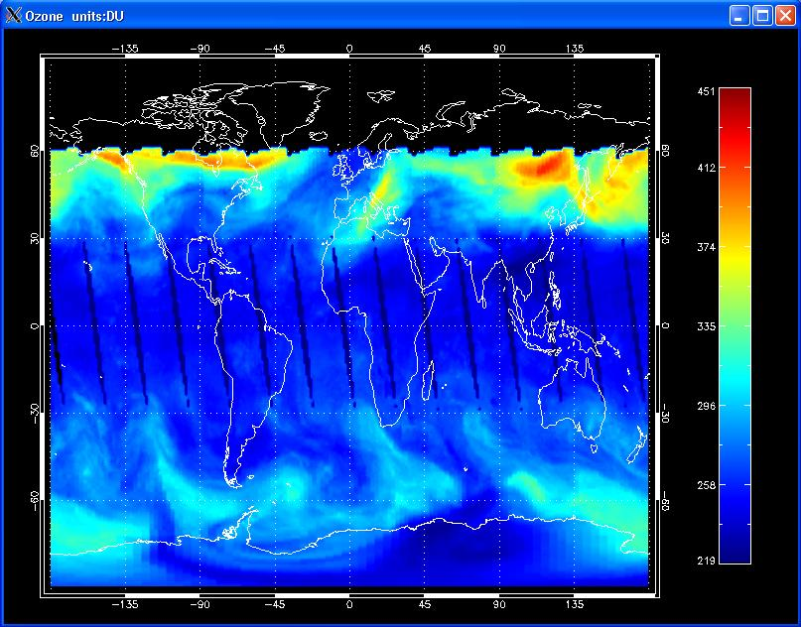
GES DISC TOMS Grid
…
;retrieve data
grid_id = EOS_GD_ATTACH(file_id, GRID_NAME)
status = EOS_GD_READFIELD(grid_id, DATAFIELD_NAME, data)
;close file
status = EOS_GD_DETACH(grid_id)
status = EOS_GD_CLOSE(file_id)
…
;retrieve lat
;field name should be defined as "YDim:TOMS Level 3" instead of "YDim:TOMS Level 3 (dimension)"
DATAFIELD_NAME="YDim:TOMS Level 3"
index=HDF_SD_NAMETOINDEX(newFileID,DATAFIELD_NAME)
thisSdsID=HDF_SD_SELECT(newFileID, index)
HDF_SD_GETDATA, thisSdsID, lat
;retrieve lon
;field name should be defined as "XDim:TOMS Level 3" instead of "XDim:TOMS Level 3 (dimension)"
DATAFIELD_NAME="XDim:TOMS Level 3"
index=HDF_SD_NAMETOINDEX(newFileID,DATAFIELD_NAME)
…
CONTOUR, BYTSCL(data, /NAN), lon, lat, /OVERPLOT, /FILL, C_Colors=Indgen(levels)+3, Background=1, NLEVELS=levels, Color=Black
MAP_GRID, /BOX_AXES, COLOR=255
MAP_CONTINENTS, COLOR=255
…
TOMS-EP_L3-TOMSEPL3_2000m0101_v8_Ozone.idl
Notes:
IDL code and plot

Slide 32
MODAPS
MODIS Level 1 Swath

Slide 33
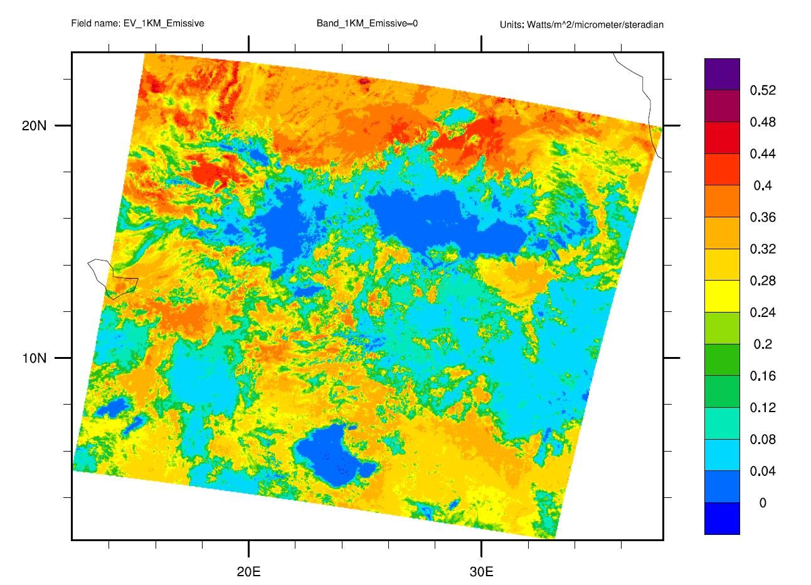
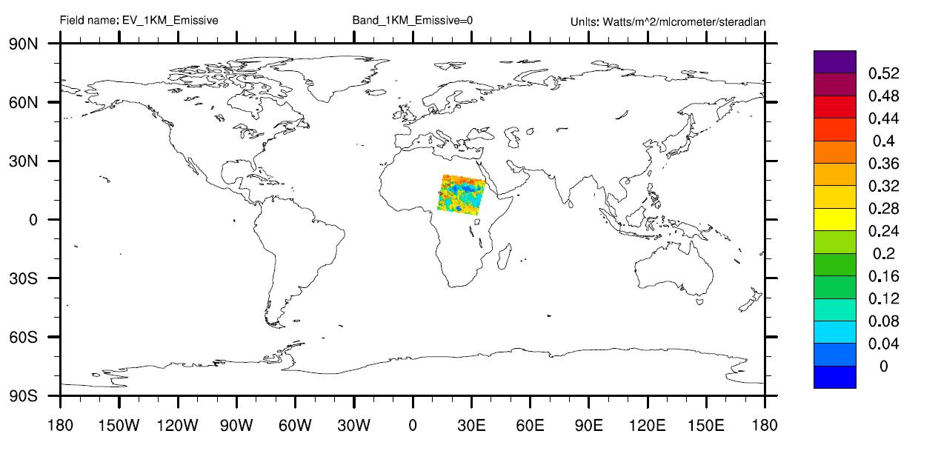
MODAPS(LAADS) Swath
MYD021KM.A2002226.0000.005.200919322273
Notes:
MYD021KM.A2002226.0000.005.2009193222735_EV_1KM_Emissive.ncl
Also add a global view if we have one.
I already add global view, the zoom view will fly in

Slide 34
MODAPS(LAADS)
MODIS Swath using dimension map
It needs additional latitude and longitude files provided by NASA
Where to obtain the corresponding latitude and longitude files?
  -ftp://ladsweb.nascom.nasa.gov/allData/5/MYD03
  Or
  ftp://ladsweb.nascom.nasa.gov/allData/5/MOD03
  MODIS Swath with dimension map

Slide 35
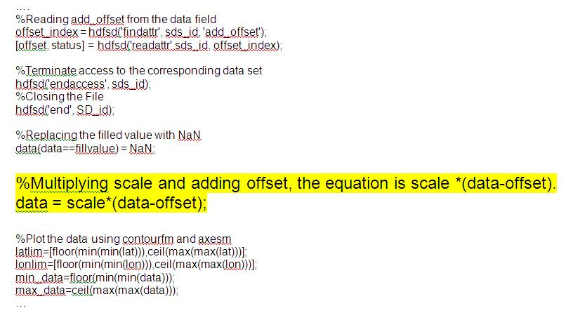
MODAPS(LAADS)
Need to apply the scale and offset factor, need special formula
Normal: Data = scale* data + offset
Matlab
Notes:
Provide the code section and circle the line that applies the scale offset.

Slide 36
NSIDC

Slide 37
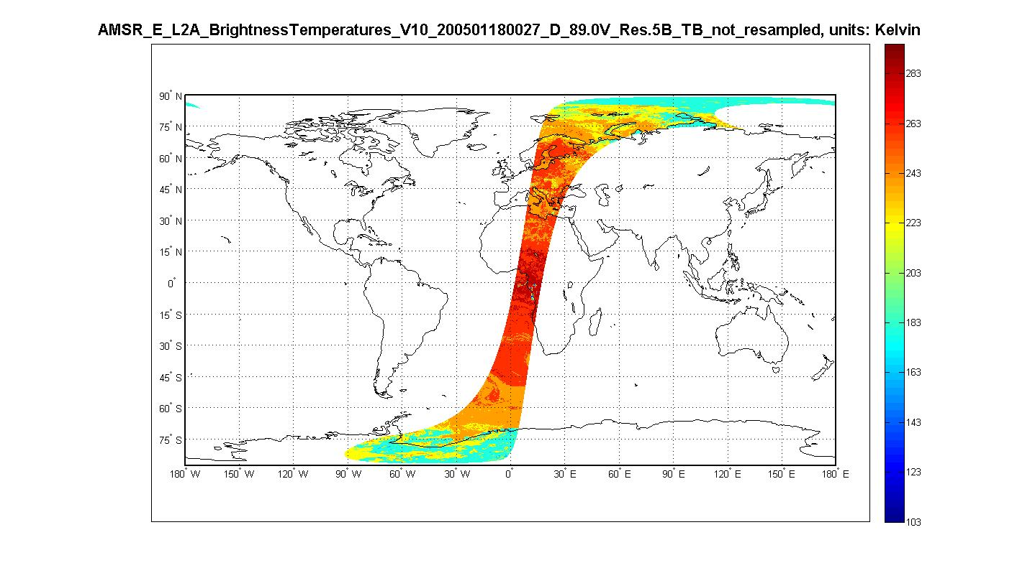
NSIDC Swath
Matlab
Notes:
Matlab

Slide 38
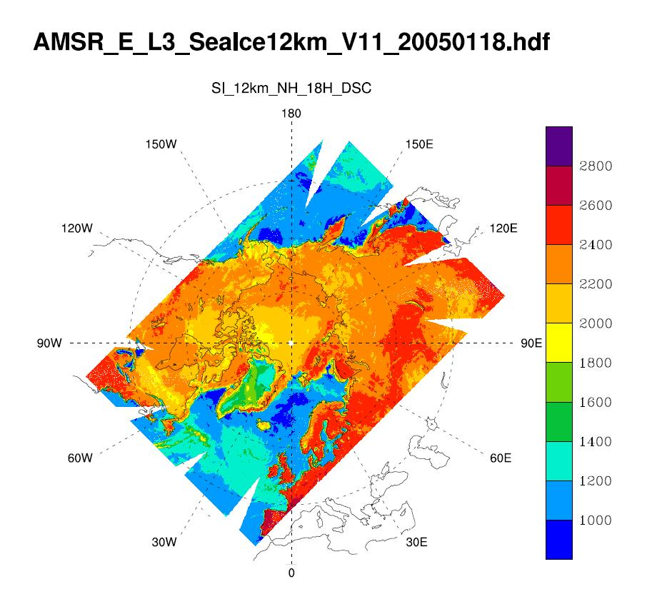
NSIDC Polar Sterographic Grid
NCL

Slide 39
LP- DAAC

Slide 40
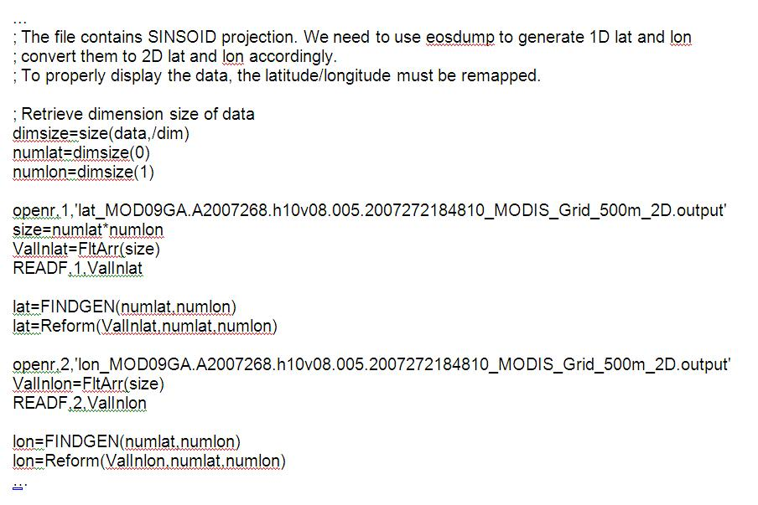
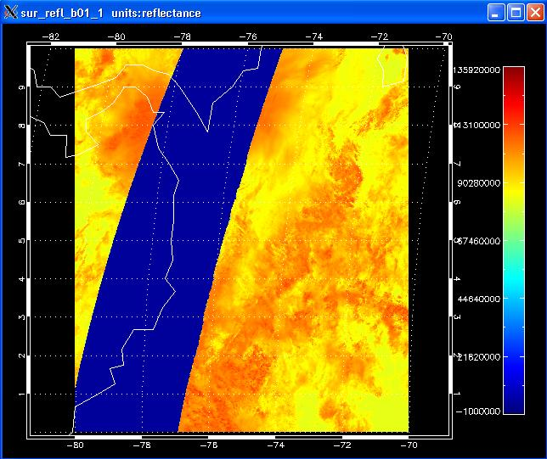
LP-DAAC Sinusoidal Grid
The lat/lon are calculated by the hdfeos2 dumper tool
http://hdfeos.org/software/eosdump.php
MOD09GA.A2007268.h10v08.005.2007272184810_sur_refl_b01_1.idl
Notes:
Add the code that reads the lat/lon.

Slide 41
PO. DAAC

Slide 42
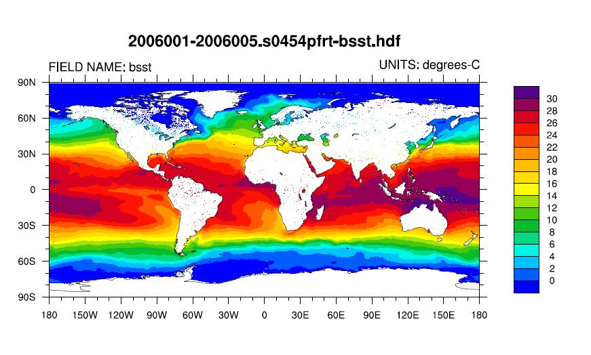
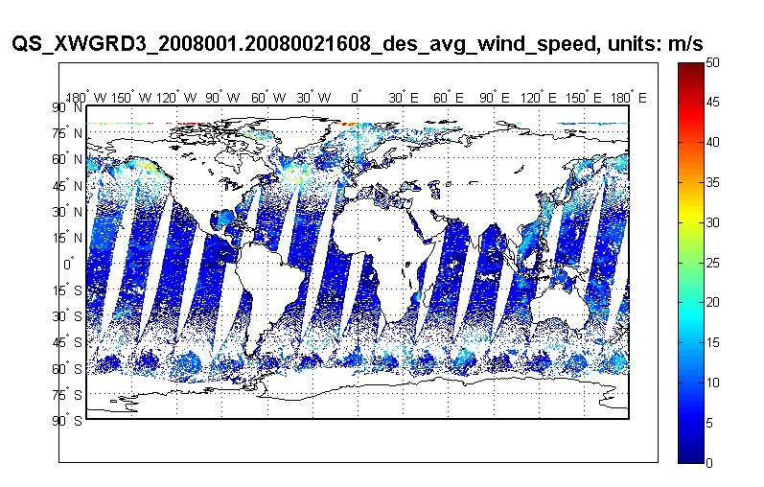
PO.DAAC Geographic Grid
Need to calculate the lat/lon based on the information provided by the product document.
NCL
Matlab

Slide 43
OBPG(Ocean Color)

Slide 44
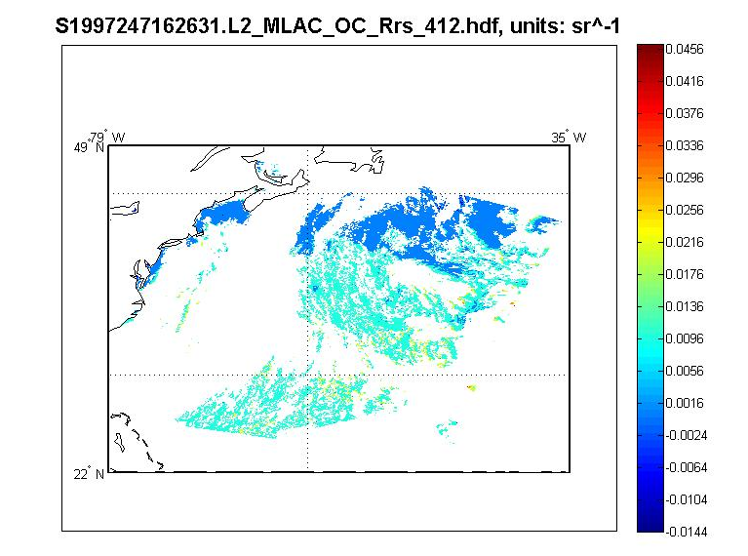
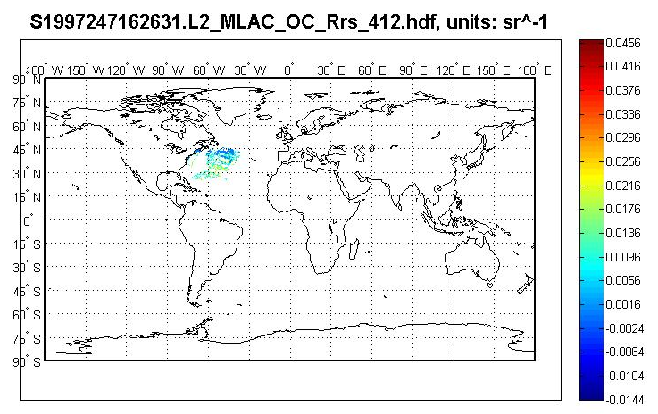
OBPG SeaWiFS
Matlab
Notes:
Replace this with http://eoszoo.hdfgroup.uiuc.edu/zoo/OBPG/S1997247162631.L2_MLAC_OC_Rrs_412_zoom.idl.JPG

Slide 45
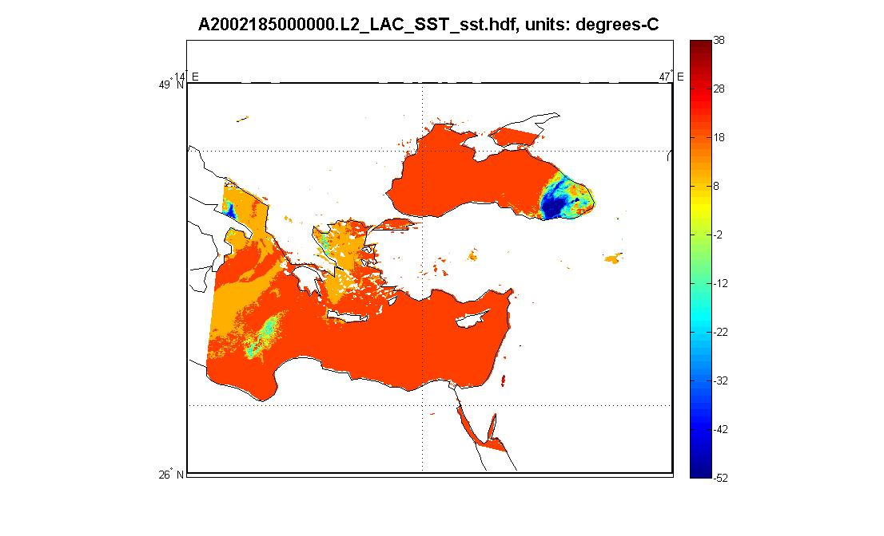
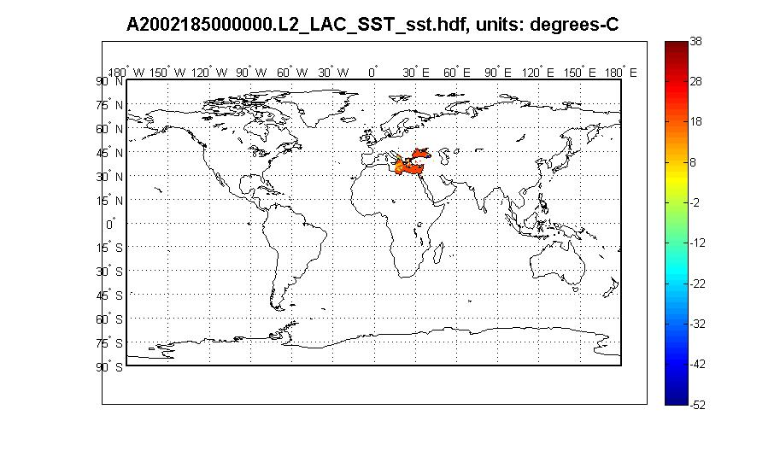
MODISA Swath
Matlab
Notes:
Add a MODIST grid Matlab plot.

Slide 46
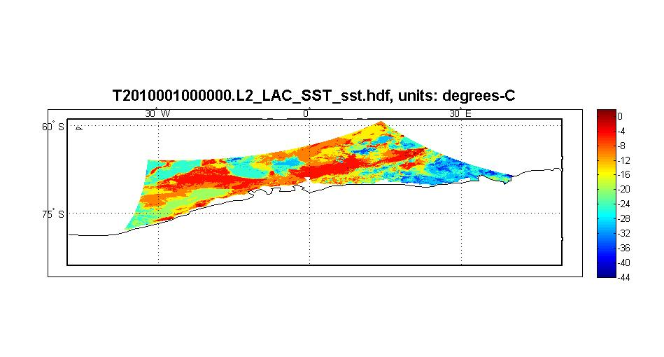
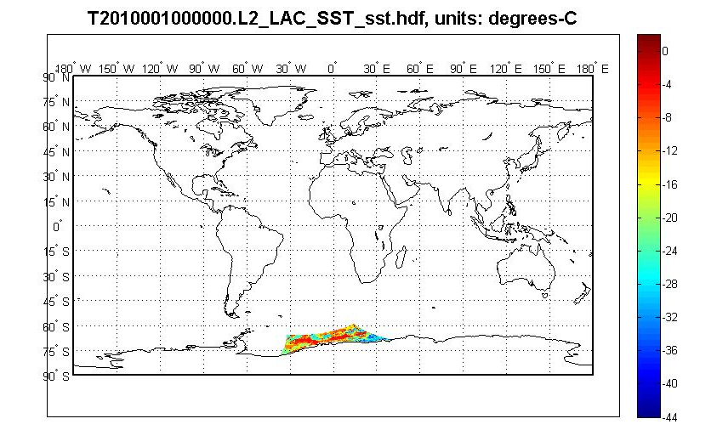
MODIST Grid
Matlab

Slide 47
GHRC

Slide 48
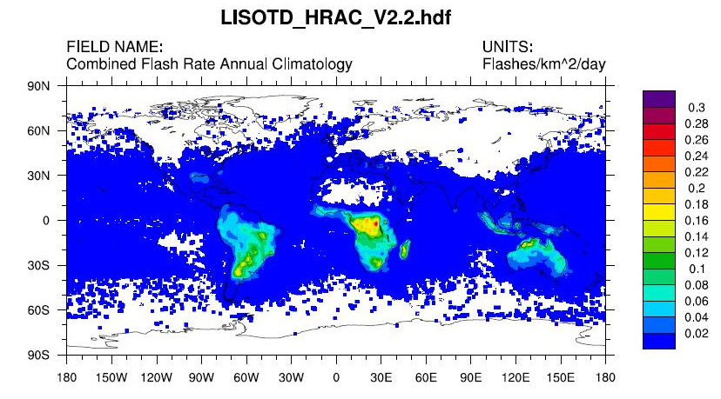
GHRC Level 3 Grid
NCL
Notes:
NCL

Slide 49
LaRC

Slide 50
LaRC
Special projections: Space Oblique Mercator (SOM)
Nested CERES Grid

Slide 51
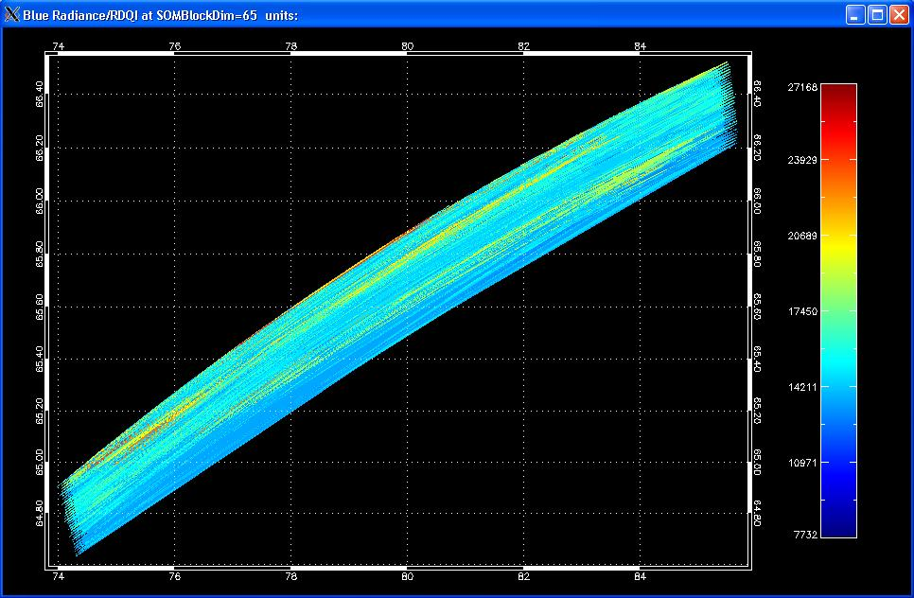
LaRC GOMACCS
Space Oblique Mercator(SOM) Grid
MISR_ELLIPSOID_GM_P017_O036105_DF_F03_0024_GOM_b64-72_Blue_RadianceRDQI.idl
Notes:
Remove this one.

Slide 52
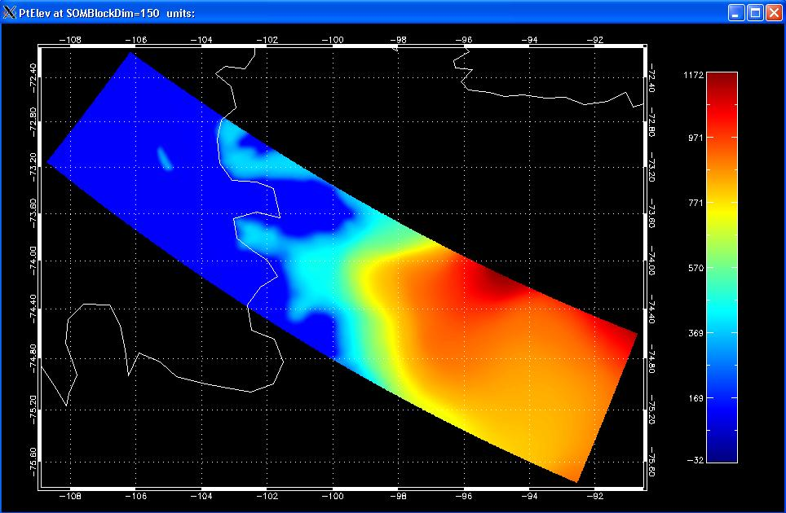
LaRC MISR SOM
MISR_AM1_AGP_P001_F01_24_PtElev.idl
Notes:
Provide the code section for lat/lon

Slide 53
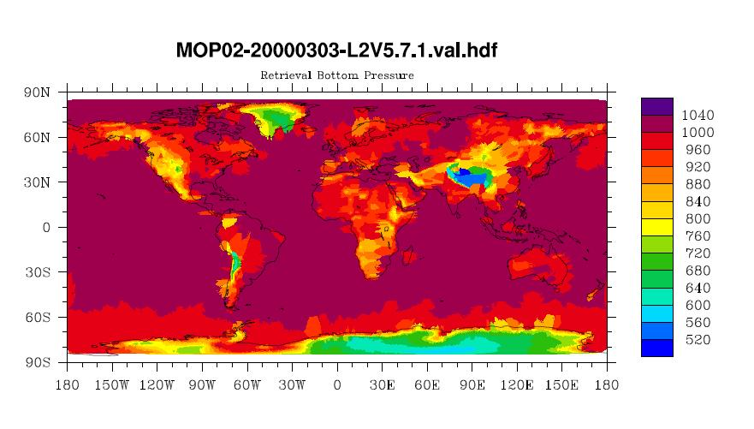
LaRC MOPITT
NCL

Slide 54
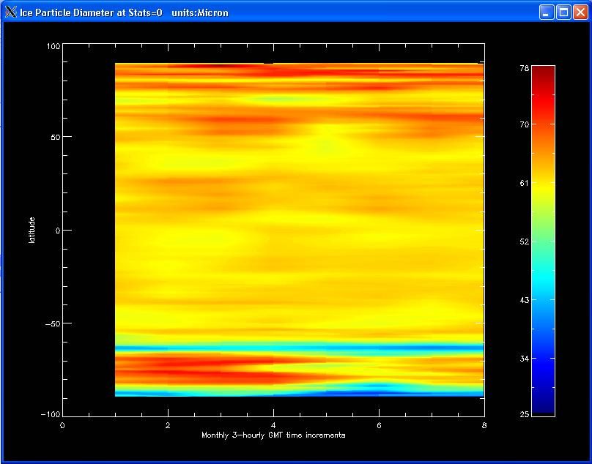
LaRC_CERES cross-section
;Open file
FILE_NAME='CER_ZAVG_Aqua-FM4-MODIS_Edition2B_007005.200503.hdf'
newFileID=HDF_SD_START(FILE_NAME, /READ)
;Define datafield
DATAFIELD_NAME='Ice Particle Diameter'
index=HDF_SD_NAMETOINDEX(newFileID,DATAFIELD_NAME)
;Retrieve data
thisSdsID=HDF_SD_SELECT(newFileID, index)
HDF_SD_GETDATA, thisSdsID, data
…
;generate lat
lat=FINDGEN(180)*(-1)+89.5
;generate ngmt
ngmt=FINDGEN(8)*1+1
…
; Start off generating the plot
levels = 250
device, decomposed=0
LoadCT, 33, Ncolors=levels, Bottom=3
WINDOW, title='Ice Particle Diameter at Stats=0'+' '+'units:'+units, XSIZE=800
CONTOUR, data2D, ngmt, lat, /Fill, C_Colors=Indgen(levels)+3, Background=1, NLEVELS=levels, Color=Black, XTITLE='Monthly 3-hourly GMT time increments', YTITLE='latitude',POSITION=[0.1, 0.1, 0.82, 0.95]
…
CER_ZAVG_Aqua-FM4-MODIS_Edition2B_007005.200503.idl
Notes:
Provide the code section on how this is plotted.

Slide 55
CERES Nested Grid
http://eosweb.larc.nasa.gov/PRODOCS/ceres/SRBAVG/Quality_Summaries/srbavg_ed2d/nestedgrid.html
Such projection is not supported. We have to emulate the projection.

Slide 56
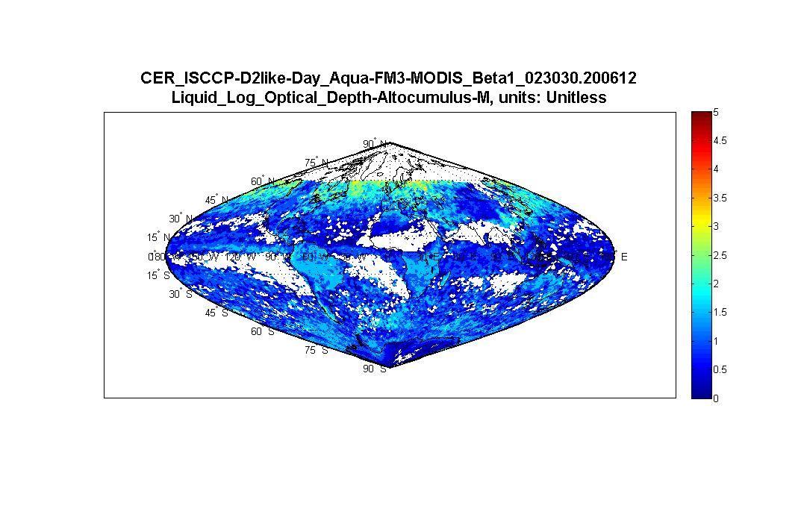
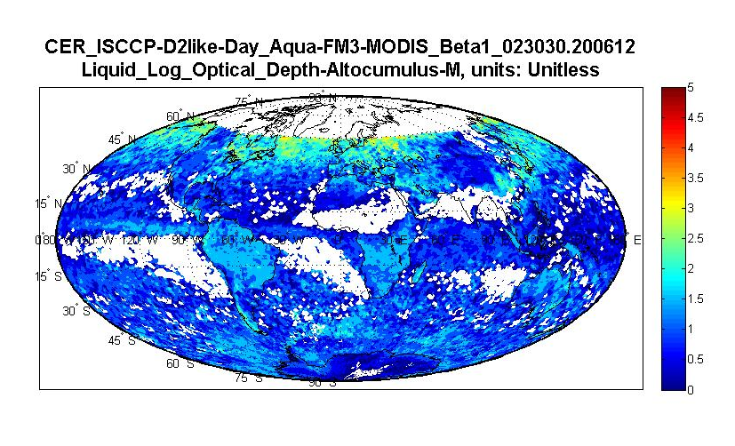
LaRC_CERES
Hammer
Sinusoidal

Slide 57
Limitations
No tools can generate LAMAZ(Lambert Azimuthal projection ) grid properly.
No latitude and longitude files can be found for 250 meter and 500 meter MOD and MYD swaths using dimension maps distributed by MODAPS.
Some tools don’t support all projections.

Slide 58
Again
Example codes and plots are under
http://hdfeos.org/zoo
We welcome you to send us feedback on these examples. You can use the HDF-EOS forum(http://hdfeos.org/forums) to share your comments or contact us at eoshelp@hdfgroup.org .

Slide 59
Thank you !

Slide 60
Acknowledgements
This work was supported by cooperative agreement number NNX08AO77A from the National Aeronautics and Space Administration (NASA).
Any opinions, findings, conclusions, or recommendations expressed in this material are those of the author[s] and do not necessarily reflect the views of the National Aeronautics and Space Administration.

Slide 61
Questions/comments?

