Slide 1


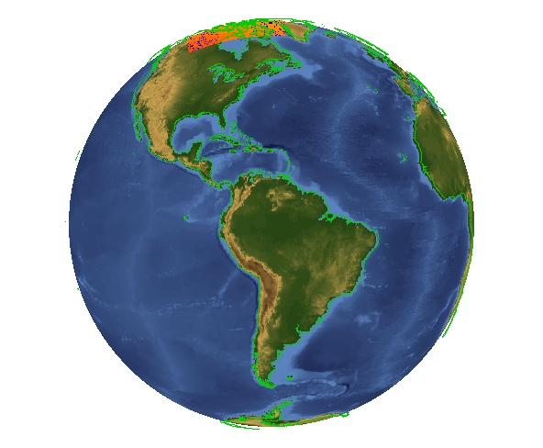
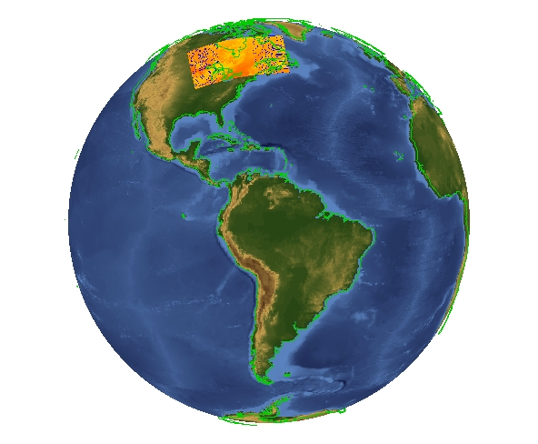
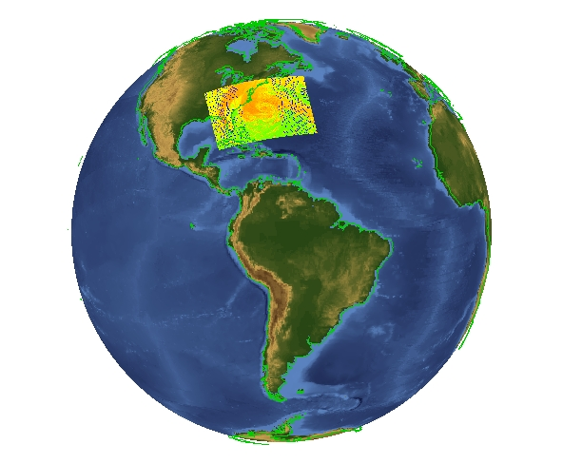
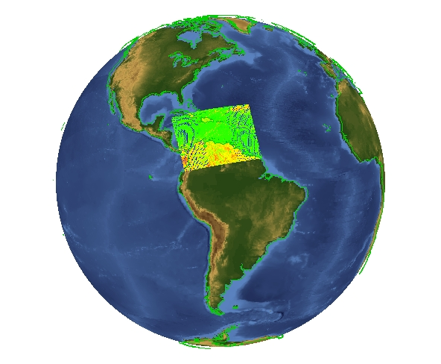
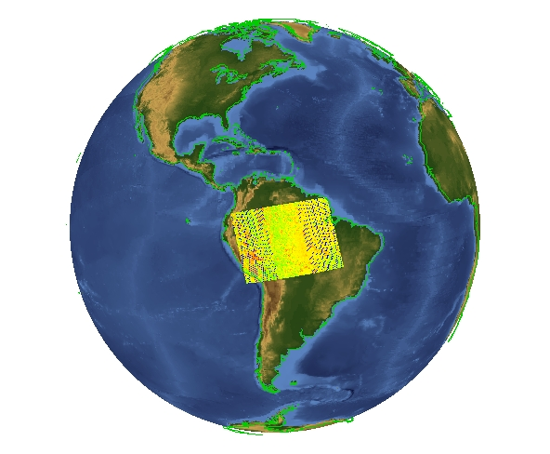
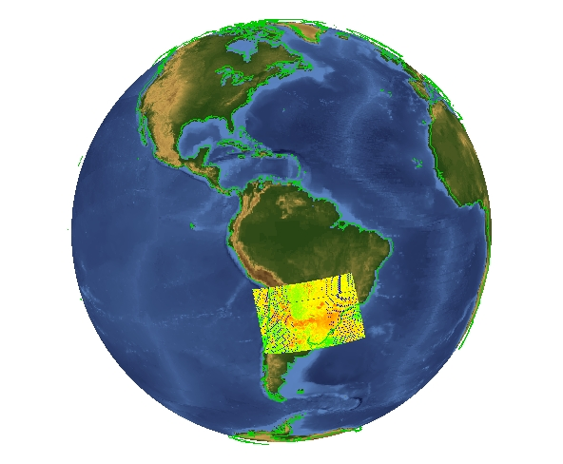
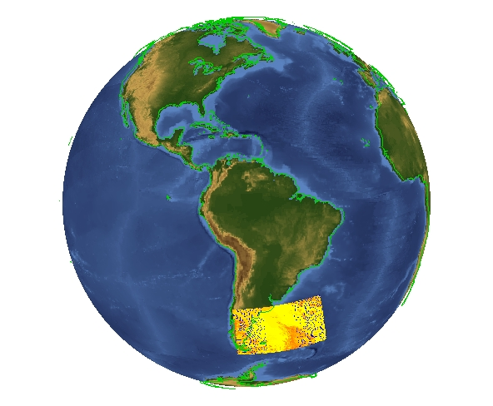
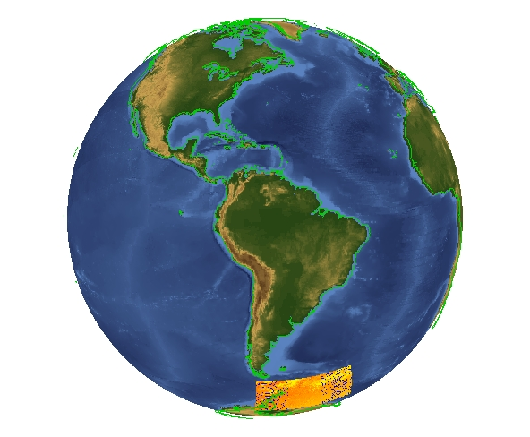
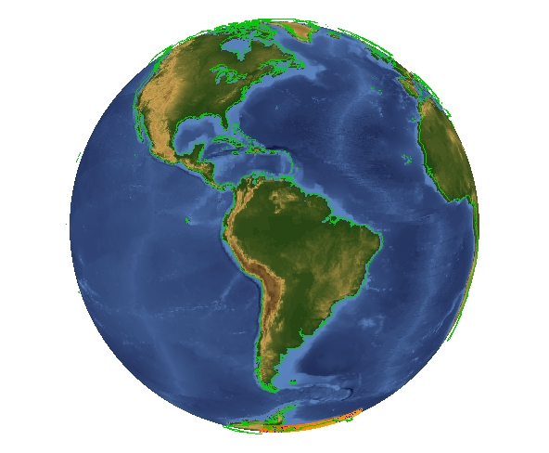
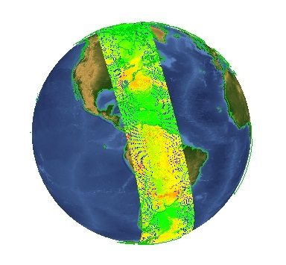

Nagg: a Tool to Aggregate and Package JPSS Products
Easy Aggregation of Satellite Data Granules
Albert Cheng¹, Mike Folk¹, Alfreda Hall ², Larry Knox¹, Elena Pourmal¹, Richard Ullman²
¹The HDF Group, ²NASA.
What is nagg?
Example: Aggregation of VIIRS Moderate Band 07 data packaged with GMODO geolocation data
Nagg is a tool for rearranging NPP data granules from existing files to create new files with a different aggregation number or a different packaging arrangement.
Command: nagg –n 36 –t SVM07 GMODO-SVM07_npp_d2012*.h5
What does nagg do?
+
+
+
+
Aggregates NPP data and GEO product
granules. Nagg can increase or decrease
the number of data granules per output file
for all products in the file.
Packages NPP data products with matching
spatial and temporal extents and GEO products.
Separates all products or extracts selected products.
Provides processing flexibility with command line options to set aggregation number, products to process, packaged or not, with GEO or not, & more.
IDV images
of radiance datasets in
each input
file
+
+
+
+
=
IDV image of radiance datasets in 36 VIIRS-M7-SDR aggregated in output file
GMODO-SVM07_npp
_d20121028_t1702335
_e1810500_..._XXX.h5
(1 pass of the Suomi NPP satellite) Oct 28, 2012
How does nagg work?
The example at right illustrates nagg’s aggregation of 36 VIIRS Moderate Band 07 granules from 9 input files. Nagg concatenates the input granules in the output file, which is structured according to the JPSS Common Data Format Control Book. The new aggregation contains the data from a complete daytime pass of the Suomi NPP satellite.
More information, download Linux64 binary:
Acknowledgements: This work was supported by subcontract number HDF-1000 under Riverside Technology, Inc. prime contract number DG133E07CQ0055, funded by the National Oceanic and Atmospheric Administration (NOAA)/National Environmental Satellite, Data and Information Services (NESDIS) ), under the direction of the NASA JPSS program. Images created by the IDV application developed at the Unidata Program Center/UCAR.
hdfgroup.org/projects/jpss

