Slide 1


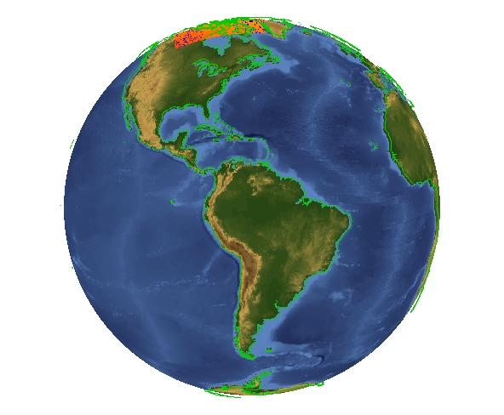
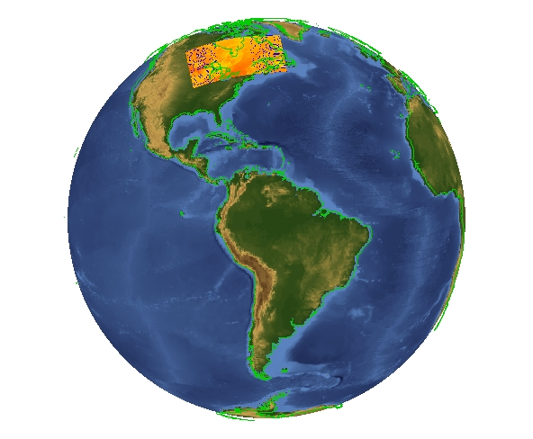
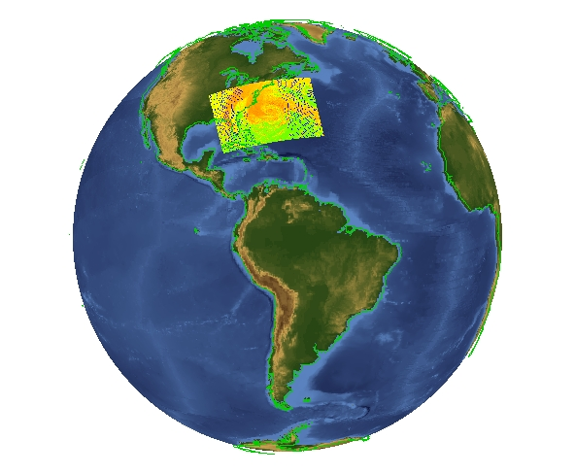
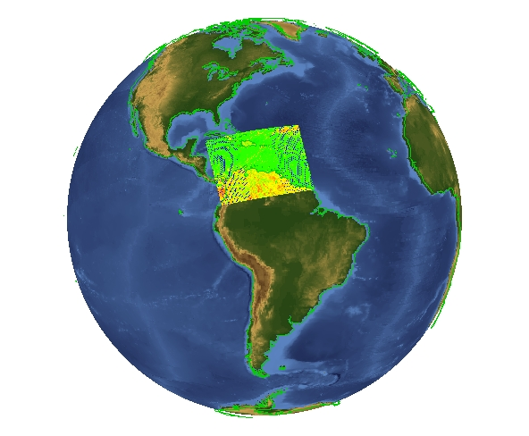
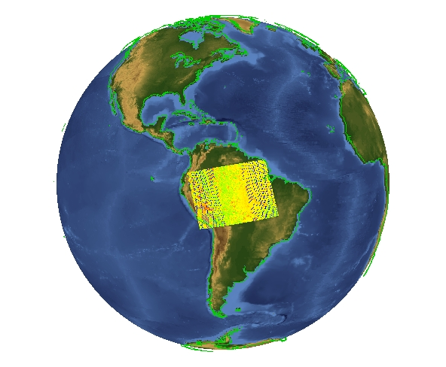
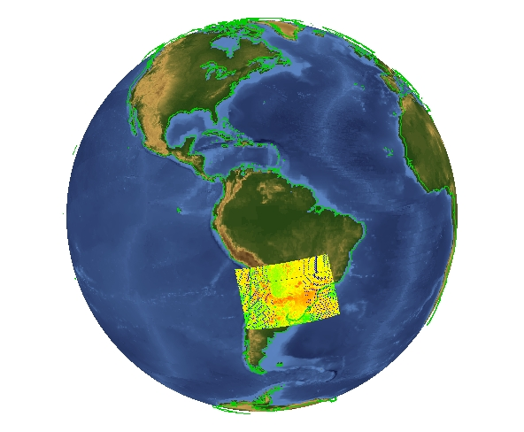
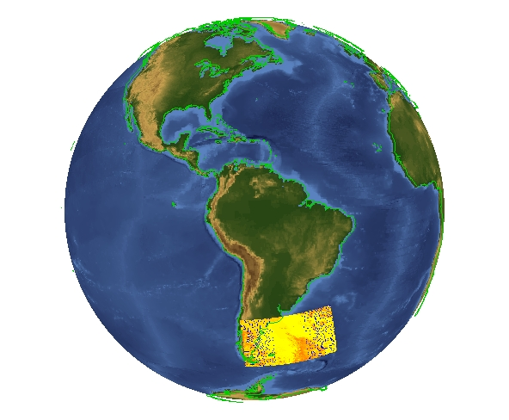
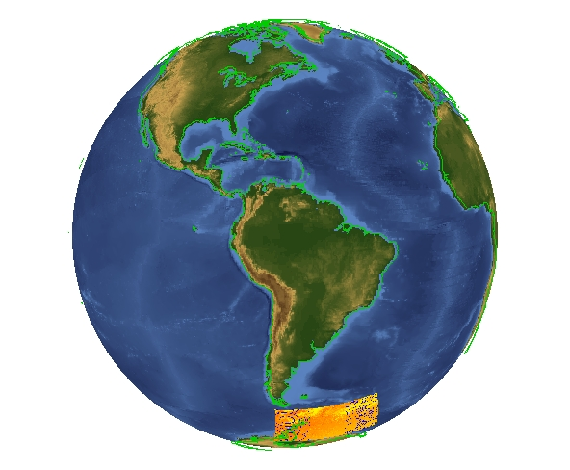
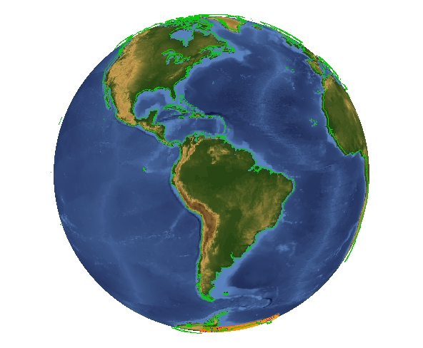
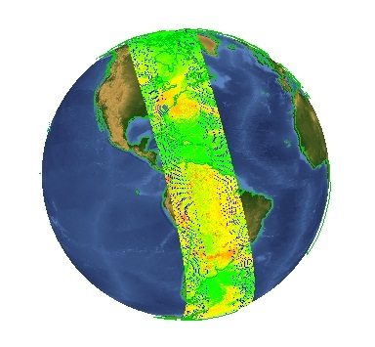

Nagg: a Tool to Aggregate and Package JPSS Products
Easy Aggregation of Satellite Data Granules
Albert Cheng¹, Mike Folk¹, Alfreda Hall ², Larry Knox¹, Elena Pourmal¹, Richard Ullman²
¹The HDF Group, ²NASA.
What is nagg?
Example: Aggregation of VIIRS Moderate Band 07 data packaged with GEO data
Nagg is a tool for rearranging NPP data granules from
existing files to create new files with a different
aggregation number or a different packaging arrangement.
Command: nagg –n 36 –t SVM07
GMODO-SVM07_npp_d20121028_t1*.h5
What does nagg do?
Aggregates NPP data and GEO product granules. Nagg can increase or decrease the number of data granules per output file for all products in the file.
Packages compatible NPP data and GEO products. Granules of all products in a file to be processed must have matching temporal and spatial extents and a matching GEO
product. Nagg can also separate all products or extract any combination of products from a packaged file.
Provides processing flexibility with command line options. These options control settings such as aggregation number, products to process, packaged or unpackaged output, whether to process GEO files, and output directory.
+
+
+
+
+
+
+
+
=
Small globes show 4 granules in each input file,
Large globe shows 36 VIIRS-M7-SDR granules in output file
GMODO-SVM07_npp
_d20121028_t1702335
_e1810500_..._XXX.h5
(radiance datasets, 1 pass of the Suomi NPP satellite) Oct 28, 2012,
IDV 3.1 display.
How does nagg work?
The example at right illustrates nagg’s aggregation of
36 granules from 9 input files with 4 granules in each
file. Nagg concatenates the granules from the input
files in the output file, which is structured according to
the JPSS Common Data Format Control Book. The new aggregation contains the VIIRS Moderate Band 07 data from a complete daytime pass of the Suomi NPP satellite.
More information, download Linux64 binary:
Acknowledgements: This work was supported by subcontract number HDF-1000 under Riverside Technology, Inc. prime contract number DG133E07CQ0055, funded by the National Oceanic and Atmospheric Administration (NOAA)/National Environmental Satellite, Data and Information Services (NESDIS) ), under the direction of the NASA JPSS program. Images created by the IDV application developed at the Unidata Program Center/UCAR.
hdfgroup.org/projects/jpss

