Slide 1




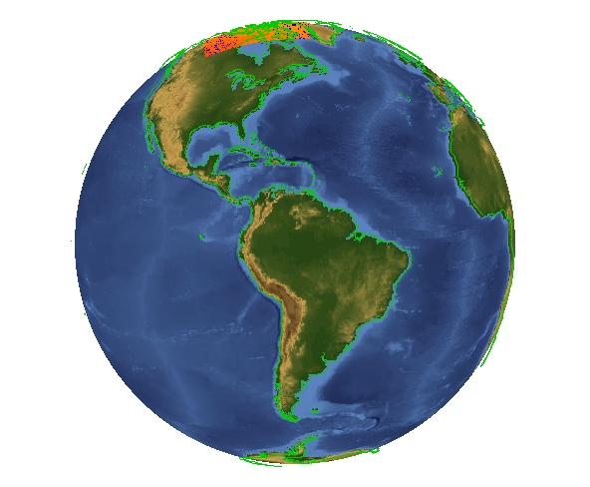
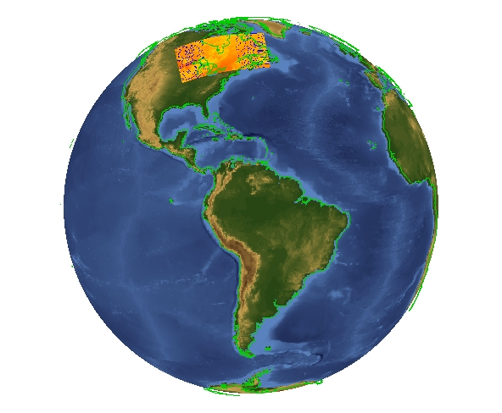
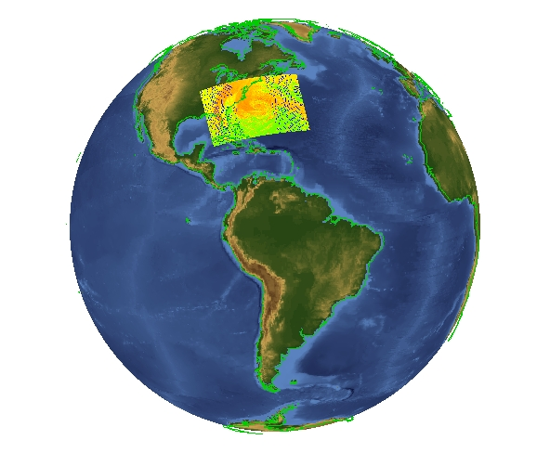
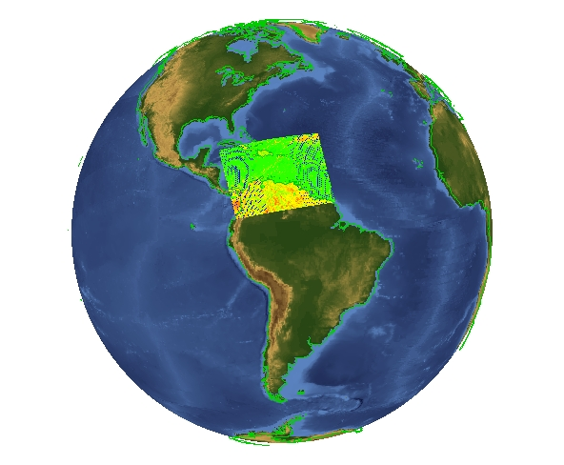
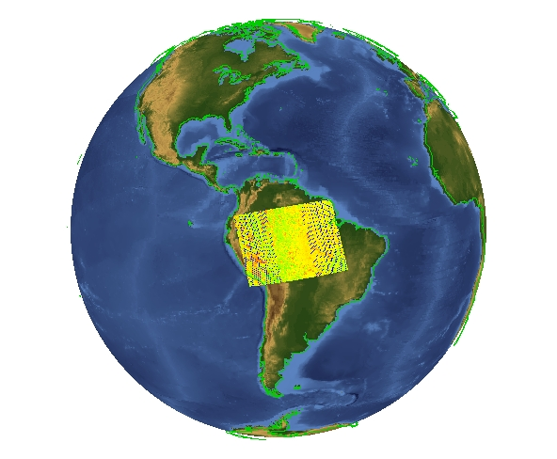
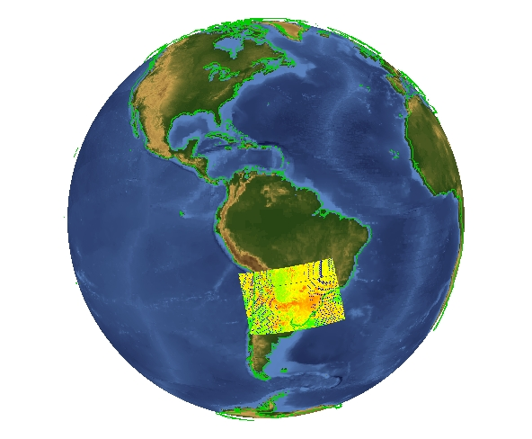
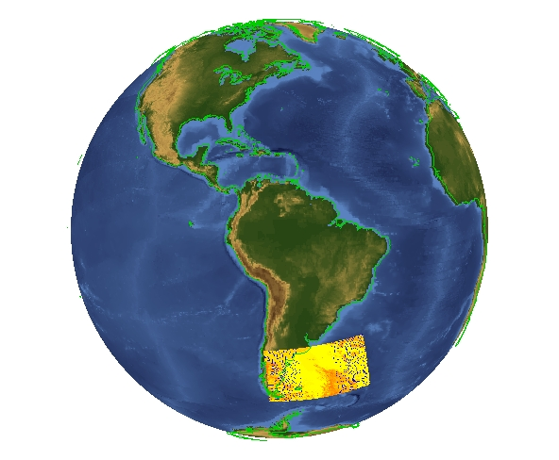
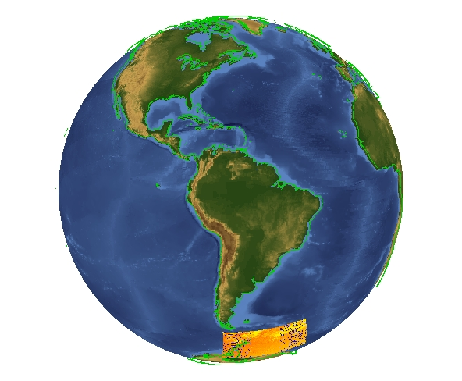
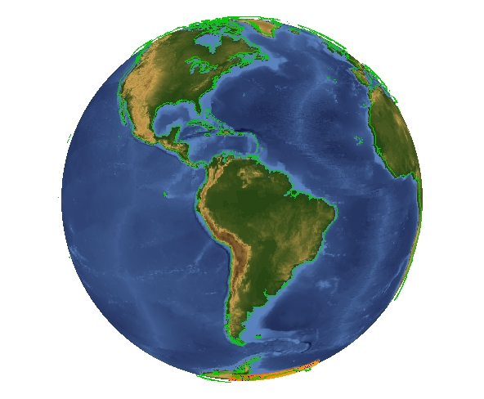
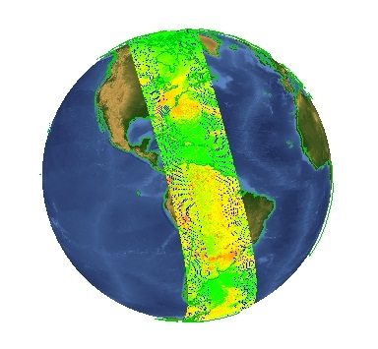
Nagg: a tool to Aggregate and Package JPSS Products
Basic nagg Syntax
Acknowledgements
nagg [OPTIONS] <input_file>...
OPTIONS:
-h, --help
Print command syntax; list valid & compatible types
-t <list>, --type=<list>
<list> specifies a comma separated list of NPP
record type mnemonics. Unless -S is specified, the
granule types will be packaged together. Types
must be compatible to be packaged together. (Use
–h to list valid package groupings).
-n <N>, --number=<N>
<N> is the number of granules of each product in
each aggregate file; <N> must be greater than 0.
If not specified, default is 1 (single granule files).
-A <t>
<t> is the aggregation time span in seconds
of each aggregate file; must be a positive integer.
-g <criterion>, --geolocation=<criterion>
<criterion>, the criterion for finding the GEO granules
no | 0: Aggregate product files with no GEO input
or output.
yes | 1: Process Geolocation files, near matching
of input filenames allowed.
strict | 2: Require exact match GEO filenames.
<geoproduct>: aggregate Geolocation product
<geoproduct> only.
-l <example>, --like=<example>
Package like the <example> file in number of
granules and type list.
<example> must be an existing NPP file. Command
line options override the number of granules and
type list from the <example> file.
-d <directory>, --directory=<directory>
<directory> is name of an existing directory in which
output NPP files are created,
-S, --simple
Simple aggregates are produced. Each type is
packaged separately. Default is to package all types.
-O <origin>
<origin> is the four character origin identifier.
Default is "XXXX".
-D <domain>
<domain> is the three character domain identifier.
Default is "XXX".
<input file> is a list of one or more NPP files.
This work was supported by subcontract number HDF-1000 under Riverside Technology, Inc. prime contract number DG133E07CQ0055, funded by the National Oceanic and Atmospheric Administration (NOAA)/National Environmental Satellite, Data and Information Services (NESDIS) ), under the direction of the NASA JPSS program. Images created by the IDV application developed at the Unidata Program Center/UCAR.
More information,
download Linux64 binary:
hdfgroup.org/projects/jpss
Easy Aggregation of Satellite Data Granules
+
+
+
+
+
+
+
+
=
Contact Information
Website: http://www.hdfgroup.org/
Help Desk: help@hdfgroup.org
General inquiries:
http://www.hdfgroup.org/about/contact.html
The HDF Group
1800 South Oak Street, Suite 203
Champaign, Illinois 61820
(217) 531-6100

Slide 2
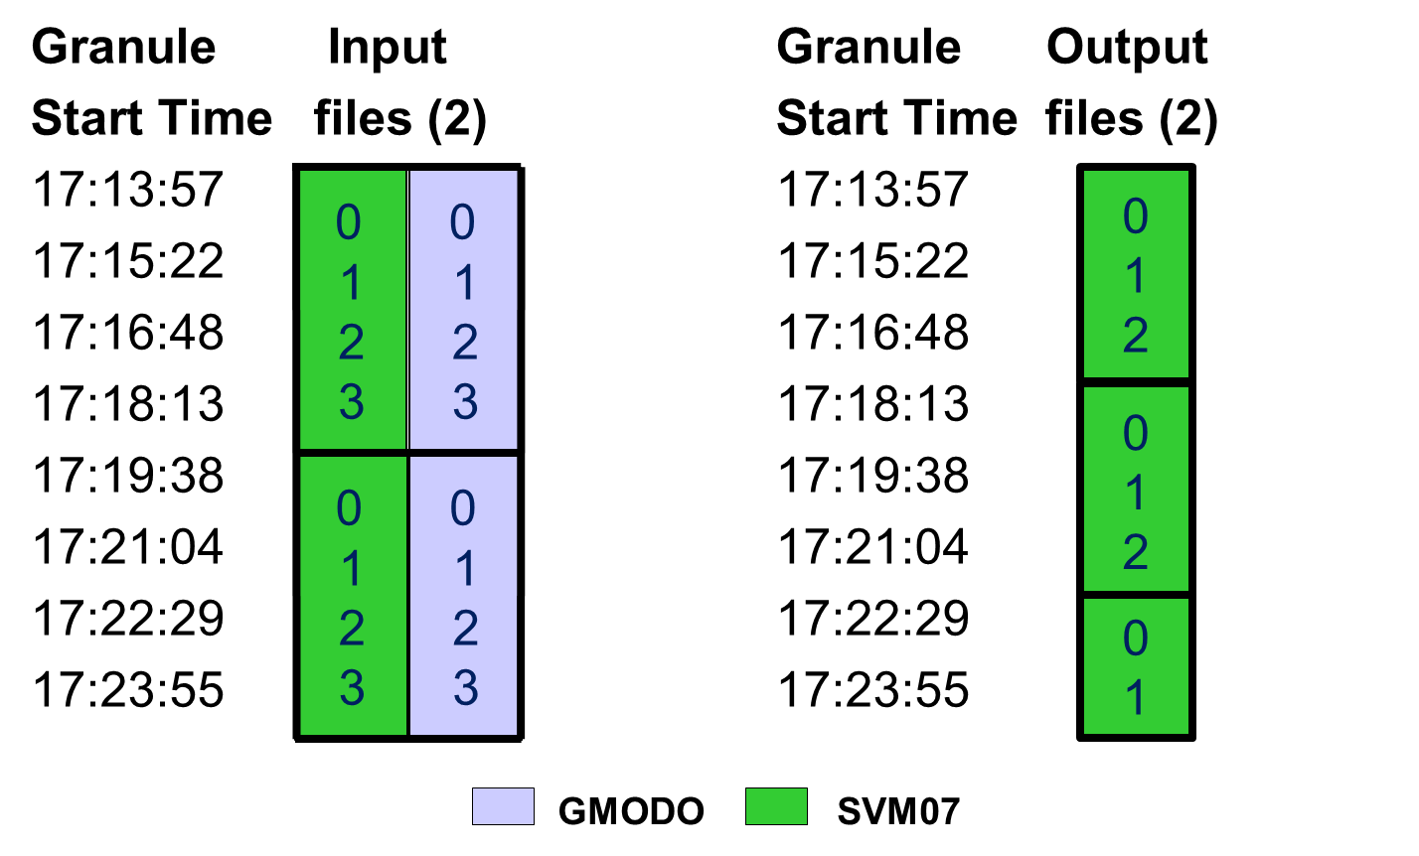
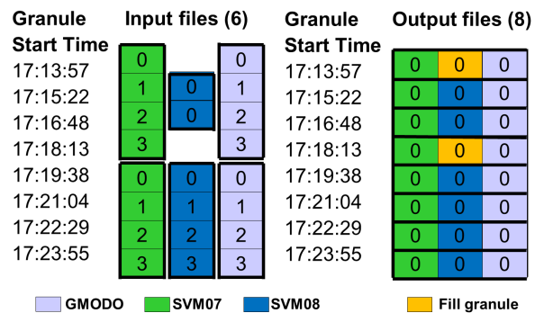
What is nagg?
Aggregation of 36 VIIRS Granules
Re-aggregation without Geolocation
Nagg is a tool for rearranging NPP data granules from existing files to create new files with a different aggregation number or a different packaging arrangement
Create a 36 granule aggregation from 9 files with 4 data and 4 GEO granules in each file.
Decrease number of granules per aggregation from 4 to 3; no GEO in output
Command: nagg - n44 -tSVM07
GMODO-SVM07_npp_d2012*.h5
Input files (9)
Output file (1)
Command: nagg –g no –A 250 –t SVM07
–d outdir1 GMODO-SVM07_npp_d20121028*.h5
What does nagg do?
0
1
2
3
0
1
2
3
Each input file has 4 granules in the VIIRS-M7-SDR group and 4 granules in the VIIRS-MOD-GEO group. These granules hold the data for a sequence of VIIRS Moderate Band 07 scans from 17:13:57 to 18:50;08 GMT 2012-10-28. The output file has the same structure with all of the data granules in one file.
The -n indicates the number of granules to aggregate per output file. “nagg -n 36” for these files would create 2 files, one with 28 granules and the other with 8. This division occurs because of the way buckets are prescribed in the Control Book. The smallest aggregation number for –n with a bucket that contains all 36 of these granules is 44, which was used in this example.
Nagg produces partial aggregations at the beginning or end of data to be processed because it does not create fill granules before the first or after the last input granule. It will create fill granules for missing granules between input granules or to match granules of another product when packaging.
For detailed explanations and examples of aggregation buckets and fill granules please see documentation at hdfgroup.org/projects/jpss or the JPSS Common Data Format Control Book at jointmission.gsfc.nasa.gov/science/documents.html
0
1
2
3
4
5
6
7
8
9
10
11
12
13
14
15
16
17
18
19
20
21
22
23
24
25
26
27
28
29
30
31
32
33
34
35
36
0
1
2
3
4
5
6
7
8
9
10
11
12
13
14
15
16
17
18
19
20
21
22
23
24
25
26
27
28
29
30
31
32
33
34
35
36
Aggregates NPP data and GEO product granules. Nagg can increase or decrease the number of data granules per output file for all products in the file.
Packages compatible NPP data and GEO products. Granules of all products in a file to be processed must have matching temporal and spatial extents and a matching GEO product.
Separates all products or extracts selected products from a packaged file.
Provides processing flexibility with command line options. These options control settings such as aggregation number, products to process, packaged or unpackaged output, whether to process GEO files, and output directory.
0
1
2
3
0
1
2
3
0
1
2
3
0
1
2
3
-A 250 produces 3 – 85.3 second granules per aggregation for the SVM07 and GMODO products.
-g no directs nagg not to process GEO granules. The 3rd output file is a partial aggregation.
0
1
2
3
0
1
2
3
0
1
2
3
0
1
2
3
Packaging & Aggregation
Package SVM07,SVM08,GMODO products
Command: nagg –t SVM07,SVM08 –d outdir2 SVM07*.h5 SVM08*.h5
How does nagg work?
0
1
2
3
0
1
2
3
Nagg concatenates the granules from the input files in the output file , which is structured according to the JPSS Common Data Format Control Book. The images on the cover show on the small globes IDV visualizations of 36 VIIRS Moderate Band 07 data granules downloaded from the NOAA CLASS website in 4 granule aggregations, and on the large globe IDV visualization of the same 36 data granules aggregated by nagg in a single file. The center column represents an internal view of the same aggregation by nagg. The examples in the far right column illustrate other nagg capabilities and command options.
0
1
2
3
0
1
2
3
0
1
2
3
0
1
2
3
The default packaged output (including GEO) and aggregation number 1 apply since -S and -n are not specified. Nagg generates fill granules with fill values specified in the JPSS Common Data Format Control Books for missing granules to match packaged products.
0
1
2
3
0
1
2
3
GMODO SVM07
Notes:
While -n 36 will limit the number of granules of each product to 36 per file, the boundaries of each aggregation are predetermined by an integer number of “buckets” of the aggregation size, beginning from IET 0, 1/1/1958. The dashed line in the output file shows the “bucket” boundary for -n 36. Increasing the parameter to 144 produces a partial aggregation that is all in one “bucket”.
The input files for this example have data and GEO granules packaged in the same files, and the output is also packaged in a single file. GEO granules would also be processed from separate files accompanying the data product files, and separate GEO output files can be produced with the “-S“ option.

