Slide 1
Support for NPP/NPOESS by The HDF Group
Phase I Update
Mike Folk, Elena Pourmal, Peter Cao
The HDF Group
September 22, 2009

Slide 2
Goal
To develop and adapt HDF5 software and provide HDF5 support for NPP/NPOESS.

Slide 3
Areas of immediate need
Ensure easy and intuitive data access and use by diverse communities
Enable producers and consumers to view content, manage metadata, and convert data to other formats.
Provide high-quality, rapid-response support of HDF5 for NPOESS users at all levels.

Slide 4
Phase I Priorities
October 2008 – September 2009
  Data accessibility and usability
    Developed library of high level APIs to support NPP/NPOESS data management
  Tool development
    Modified h5dump to enable viewing of region references and quality flags
    Modified HDFView to enable viewing of region references and quality flags
  System maintenance
  User support

Slide 5
NPOESS Project Information
Project Web site
  http://www.hdfgroup.org/projects/npoess/
    Project description
    Released software
    Documentation

Slide 7
NPOESS Software FTP Site

Slide 8
NPOESS Project Information
Project Wiki site
  http://wiki.hdfgroup.org/NPOESS-Project
  Monthly progress reports, links to software under development, presentations, etc.
    Requires a password
    Contact epourmal@hdfgroup.org

Slide 10
Library of High-Level APIs to support NPOESS data

Slide 11
NPOESS High-Level Library
Library to support HDF5 region references and packed bits in support of NPOESS quality flags
  C APIs (wrappers around several HDF5 library calls)
  Documentation in html format
  Tests
  Examples
Build against HDF5 library pre-installed on the system
  Set environment variable to point to installed HDF5
  Run: make; make tests; make install to build, test and install the library
Source available from
  ftp://ftp.hdfgroup.uiuc.edu/pub/outgoing/NPOESS/source/
Still a prototype!
Notes:
A file format for managing

Slide 12
NPOESS High-Level Library
Documentation is available from
  http://www.hdfgroup.org/projects/npoess/
Notes:
A file format for managing

Slide 14
New features of h5dump

Slide 15
h5dump and Region Reference Data
Added new flag –R to display data pointed by region references
  Can be used in combinations with other flags to display only one dataset, or to display selection in the dataset, or export data to a text or binary file
Improved a way to display one element
  An element of a dataset is specified by its indices
  Can be used in combination with other flags
  Examples:
    h5dump -d “/Dataset-1dim[1]” -R file.h5
    h5dump -d “/Dataset-1dim” -s “1” -R file.h5
    h5dump -d “/Dataset-2dim[3,2]” file.h5

Slide 16
h5dump and Region Reference Data
Both changes were integrated with the HDF5 code
  Available in HDF5 1.8.4 release November 2009
  Will be available starting the following snapshots of the HDF5 software
    1.8.3-snap10 and 1.9.46
ftp://ftp.hdfgroup.uiuc.edu/pub/outgoing/hdf5/snapshots
  Pre-built binaries can be found at
    ftp://ftp.hdfgroup.uiuc.edu/pub/outgoing/NPOESS/bin

Slide 17
h5dump and Quality Flags
Added new flag –M <L> to display packed bit-field data, where <L> is a paired list of integers the first number of which is the offset and the second number is the number of bits to display
  Available only in the HDF5 NPOESS branch
  Will NOT be in HDF5 1.8.4 release
  Source and pre-built binaries can be found at
    ftp://ftp.hdfgroup.uiuc.edu/pub/outgoing/NPOESS/

Slide 18
HDFView
New Features to Support Region References and Quality Flags

Slide 19
New Features in HDFView
Features to support NPOESS specific data
  Aggregated granules
    Showing the whole dataset pointed by an object reference
  Granules
    Showing data pointed by a dataset region reference
  Quality Flags
    Showing specific bits of quality flags
      Implemented using TreeView plugin
  Available in HDFView version 2.5 patch 3
  http://www.hdfgroup.org/ftp/HDF5/hdf-java/v25p3/

Slide 20
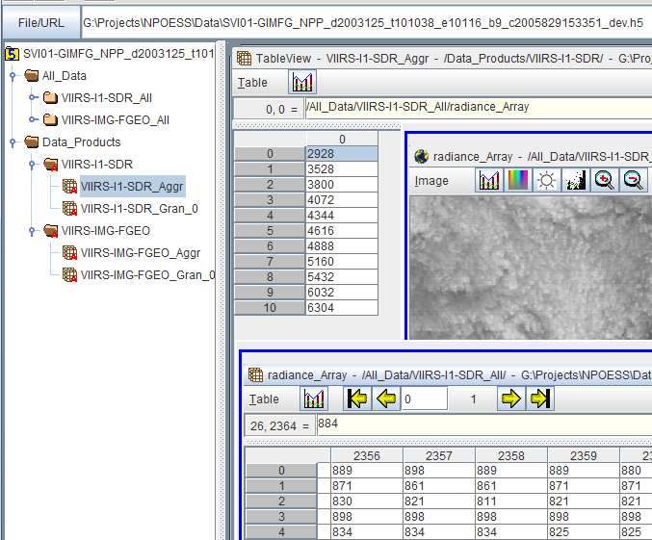
Data Pointed by Object References

Slide 21
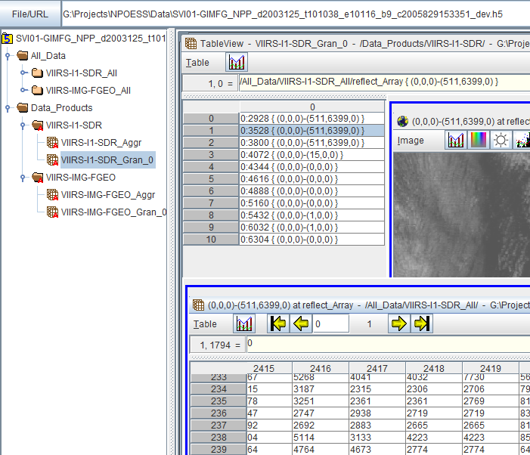
Data Pointed by Region References

Slide 22
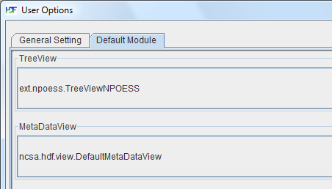
HDFView Plug-in to Display Quality Flags
Available with HDFView 2.5 patch3
Open HDFView and select the NPOESS plugin
Restart HDFView.

Slide 23
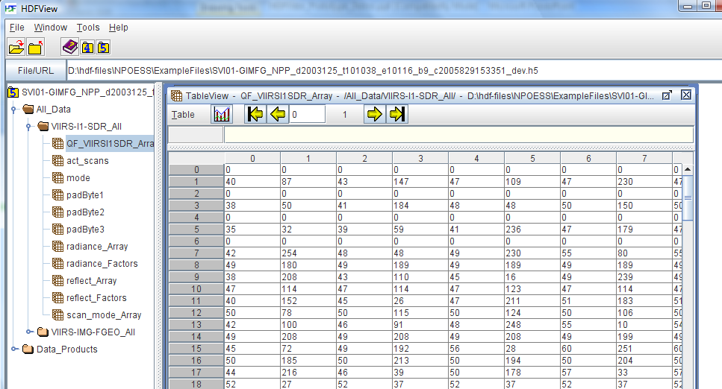
Quality Flags
  By default quality flags are shown as 8-bit decimal integers

Slide 24
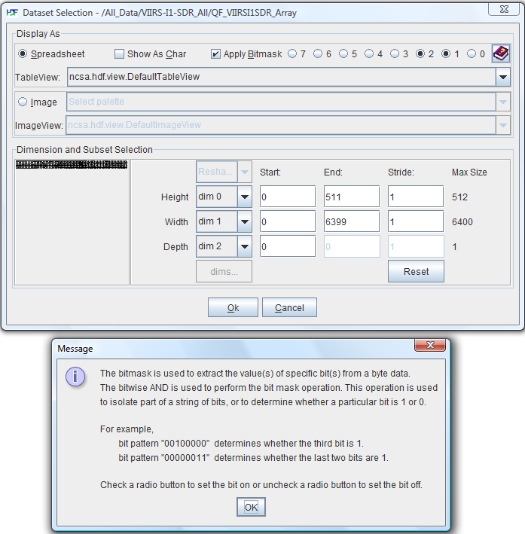
Quality Flags
Apply bitmask to show individual quality flags
Use “Open As” on the dataset of quality flags.

Slide 25
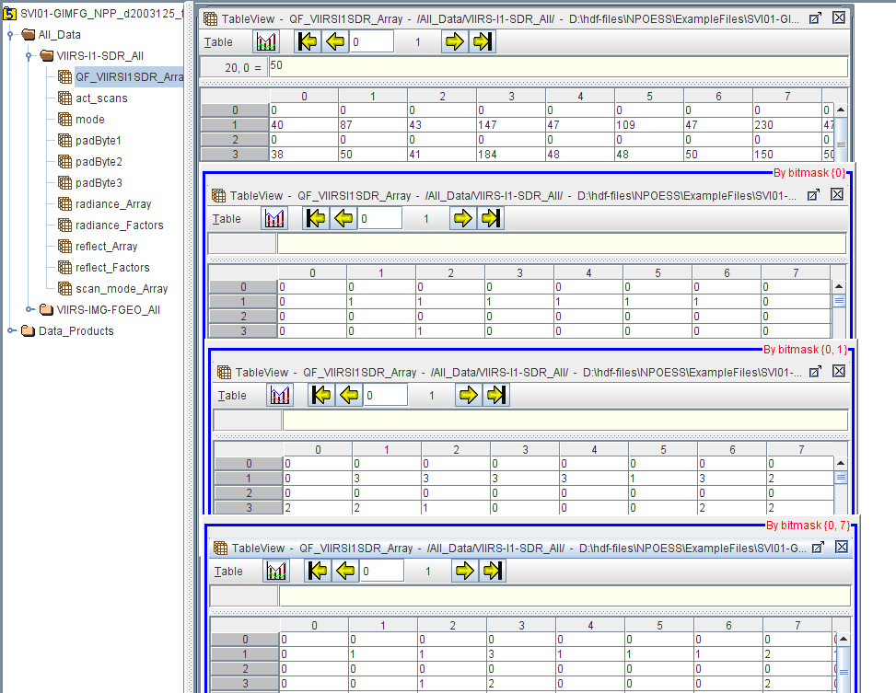
Quality Flags
Examples of bit masks
  Applied mask is shown in red at top-right, e.g., “By bitmask {0, 1}”

Slide 26
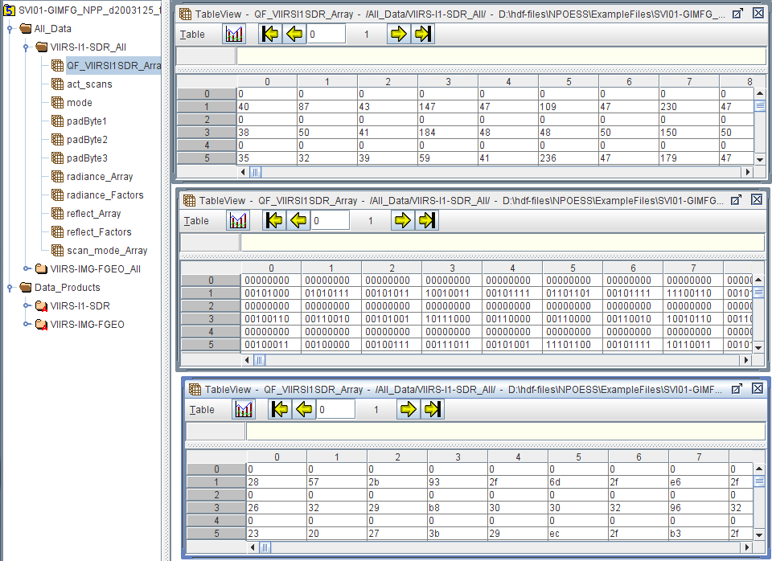
Quality Flags
Data can be displayed in decimal, binary, or hexadecimal

Slide 27
Possible Phase II Work
Add new features
  Support Variable-Length datasets
  Ease access to information about quality flags
    Use definition of quality flags, which are in two separate locations:
      The Common Data Format Control Book – External (CDFCB-X), Volumes II, III and IV
      XML files provided as part of the CDFCB-X delivery
    Apply the structure of the XML to determine whether a field is a packed quality flag byte
Enhance current features
  Extend number of options to display references, e.g., show properties of the referenced data
  Redesign and implement default implementation of TreeView and TableView to improve support for NPOESS plug-in
Improve quality of testing, documentation, and binary and source distribution

Slide 28
NPOESS System Support

Slide 29
NPOESS System Support
HDF5 daily testing on
  Linux 32 and 64-bit
  Windows
  AIX 5.3
  Solaris 32 and 64-bit
NPOESS High-Level library regular testing on
  Linux 32 and 64-bit
  Windows
  Solaris 32 and 64-bit

Slide 30
NPOESS User Support

Slide 31
NPOESS User Support
Priority support to NPOESS users
  Send email to help@hdfgroup.org
  Add NPOESS to the subject field
    Example: “Subject: [NPOESS] Where do I find the plug-in?
  Get response in less than 4 hours
Example: Ported HDF5 1.8.3 to use Lahey Fortran compiler on Windows XP
  ftp://ftp.hdfgroup.uiuc.edu/pub/outgoing/NPOESS/

Slide 32
Phase II Work
October 2009 – September 2010

Slide 33
Phase II Work
Starts on October 1 2009
Maintenance of NPOESS-specific software developed by The HDF Group
  High-Level Library
  H5dump, other tools?
  HDFView
  Testing, documentation, releases
Support HDF5 on the platforms critical to NPOESS
  Linux 64-bit
  AIX
  ?

Slide 34
Phase II Work (cont.)
NPOESS User Support
  Provide responsive and high-quality support through a helpdesk
  Continue gather requirements and enhance HDF5 software as needed
Special Maintenance Project (examples)
  Porting to requested compilers
  Performance tuning for applications
  Improved support for C++
  Support for netCDF-4 access to NPOESS SDR and EDR products

Slide 35
Phase II Work (cont.)
Special Research Project (examples)
  Analyze and propose potential improvements for HDF5 or HDF5 NPOESS products with the data management portion of the Raytheon Algorithm Development Library (ADL)
  Investigate and propose implementation of OpeNDAP server for HDF5 NPOESS SDR and EDR products
  Develop NPOESS specialized version of the HDF5 file check tool h5check
  Performance tuning of the HDF-NPOESS product file

Slide 36
Questions?

