Slide 1
Support for NPP/NPOESS by The HDF Group
Mike Folk, Elena Pourmal, Peter Cao
The HDF Group
June 30, 2009

Slide 2
Goal
To develop and adapt HDF5 software and provide HDF5 support for NPP/NPOESS.

Slide 3
NPOESS Priorities and HDF5
Data calibration/validation
Data accessibility and usability
Tool development
System maintenance
User support

Slide 4
Areas of immediate need
Ensure easy and intuitive data access and use by diverse communities
Enable producers and consumers to view content, manage metadata, and convert data to other formats.
Provide high-quality, rapid-response support of HDF5 for NPOESS users at all levels.

Slide 5
Areas of immediate need
Ensure easy and intuitive data access and use by diverse communities
  Specifically: Develop high level APIs and tools to support NPP/NPOESS data management
Enable producers and consumers to view content, manage metadata, and convert data to other formats.
  Specifically: Modify HDFView to enable viewing of region references and quality flags
Provide high-quality, rapid-response support of HDF5 for NPOESS users at all levels.

Slide 6
Update on High-Level APIs to support NPOESS data

Slide 7
Overview

Slide 8
Overview
Under current agreement The HDF Group will
  Propose, develop, and implement approaches to access data pointed to by region references, rewrite region references in datasets and access individual quality flags.
  Gather user needs and match to proposed plan, design, and design implementation. Address requirements, and inform the user communities on NPOESS HDF5 implementation and use.
This part of the presentation describes our progress on those two tasks.
Notes:
A file format for managing

Slide 9
Overview
The HDF Group has been gathering requirements through
  HDF-EOS and HDF Workshops and other conferences and meetings
  The HDF Group HelpDesk help@hdfgroup.org
  Personal contacts
The result of this work is a set of 10 new High-Level APIs to support data access in NPOESS files
Notes:
A file format for managing

Slide 10
Overview
  Links to RFCs and source code:
    Current version of RFCs and feedback from the users
  http://hdf5dev.pbworks.com/NPOESS-RFCs
    Snapshots of the HDF5 library code
  ftp://ftp.hdfgroup.uiuc.edu/pub/outgoing/NPOESS/source
    Tested on Linux 32 and 64-bit, Solaris and Windows XP
  Repository
  http://svn.hdfgroup.uiuc.edu/hdf5/branches/NPOESS
Notes:
A file format for managing

Slide 11
Overview
We need your help to
  Evaluate current APIs
    Use them
    Brake them
    Tell us what you like and do not like including documentation
  Give feedback on the implemented features
    Is anything missing?
    Did we misinterpret some of the requirements?
Phase II work will be based on feedback we get from you!
Notes:
A file format for managing

Slide 12
New APIs Highlights

Slide 13
New APIs Highlights
10 new C APIs to support HDF5 region references and packed bits in support of NPOESS quality flags
New APIs are wrappers around several HDF5 library calls
The latest versions of the documentation are available from http://hdf5dev.pbworks.com/NPOESS-RFCs
  HL APIs
    Region References
    Bit-fields
Source code is based on the HDF5 development branch
Tested daily on Linux 32 and 64-bit, Solaris, and weekly on Windows XP

Slide 14
New APIs Highlights
There will be no decision made which APIs will be brought back to the mainstream HDF5 library until we hear from NPOESS and general HDF5 community.
Consider current version as a PROTOTYPE that will help to gather and refine requirements.

Slide 15
New APIs Highlights
New region reference APIs
  Query information about data
    Get information about data pointed to by region reference (full path of the datatset, datatype, dimensionality, description of selected region, i.e., corners of the rectangular region.)
  Access region reference raw data
    Read data pointed to by a region reference to an application buffer.
    Read data described by its location in the dataset to an application buffer.
    Create dataset with raw data pointed by the array of region references.

Slide 16
New APIs Highlights
New region reference APIs (continue)
  Create region references
    Create array of region references using list of datasets names and hyperslab descriptions
    Traverse a group tree and create a new dataset with region references to all found datastes
  Gather raw data in one dataset
    Copy raw data pointed by region references to a specified location
  Copy references
    Copy raw data pointed by region reference to a specified location and create a reference to it

Slide 17
New APIs Highlights
New packed bit-field APIs
    Extracts bit-field values from a dataset into application buffer
    Deficiencies:
      HDF5 doesn’t have a knowledge about the meaning of a bit-field and currently doesn’t store any information about the packed data
      NPOESS stores information in a separate file that user has to access to find and interpret bit-filed data
      HDF5 provides several way for storing “low range data”
        N-bit data
        Different compression methods
  This API is very specific to NPOESS data

Slide 18
Update on h5dump

Slide 19
h5dump and region reference data
Added new flag –R to display data pointed by region references
Can be used in combinations with other flags to display only one dataset, or to display selection in the dataset, or export data to a text or binary file

Slide 20
h5dump example
> h5dump FileA.h5
HDF5 "FileA.h5" {
...
DATASET "R1" {
DATATYPE H5T_REFERENCE
DATASPACE SIMPLE { ( 4 ) / ( 4 ) }
DATA {
(0): DATASET /Group_1D/DS1 {(1), (6), (9), (10), (14)},
...
(3): DATASET /Group_3D/DS3 {(3,3,3)-(4,4,4)}
}
}
…

Slide 21
h5dump example (first element)
> h5dump –R FileA.h5
HDF5 "FileA.h5" {
...
DATASET "R1" {
DATATYPE H5T_REFERENCE
DATASPACE SIMPLE { ( 4 ) / ( 4 ) }
DATA {
(0): DATASET /Group_1D/DS1 {
(0): REGION_TYPE POINT (1), (6), (9), (10), (14)
(0): DATATYPE H5T_STD_I32LE
(0): DATASPACE SIMPLE { ( 17 ) / ( 17 ) }
(0): DATA {
(1): 1,
(6): 6,
(9): 9,
(10): 10,
(14): 14
…

Slide 22
h5dump example (fourth element)
> h5dump –R FileA.h5
HDF5 "FileA.h5" {
...
(3): DATASET /Group_3D/DS3 {
(3): REGION_TYPE BLOCK (3,3,3)-(4,4,4)
(3): DATATYPE H5T_STD_I32LE
(3): DATASPACE SIMPLE { ( 6, 6, 6 ) / ( 6, 6, 6 ) }
(3): DATA {
(3,3,3): 444, 445,
(3,4,3): 454, 455,
(4,3,3): 544, 545,
(4,4,3): 554, 555
(3): }
(3): }
…

Slide 23
h5dump and packed bit-field data
Added new flag –M <L> to display packed bit-field data, where <L> is a paired list of integers the first number of which is the offset and the second number is the number of bits to display
Deficiencies:
  Information in <L> has to be provided by a user
  HDF5 library doesn’t have a knowledge how data is packed.

Slide 24
h5dump example
> h5dump -d /Data_Products/Gran_1 sds.h5
HDF5 "sds.h5" {
DATASET "/Data_Products/Gran_1" {
DATATYPE H5T_STD_U8BE
DATASPACE SIMPLE { ( 768, 3200 ) / ( H5S_UNLIMITED, H5S_UNLIMITED ) }
DATA {
(0,0): 3, 3, 3, 3, 3, 3, 3, 3, 3, 3, 3, 3, 3, 3, 3, 3, 3, 3, 3,
(0,19): 3, 3, 3, 3, 3, 3, 3, 3, 3, 3, 3, 3, 3, 3, 3, 3, 3, 3, 3,
(0,38): 4, 4, 4, 4, 4, 4, 4, 4, 4, 4, 4, 4, 4, 4, 4, 4, 4, 4, 4,
...
(767,3191): 65533, 65533, 65533, 65533, 65533, 65533, 65533,
(767,3198): 65533, 65533
}
}
}

Slide 25
h5dump example
> h5dump -d /Data_Products/Gran_1 -M 0,2 sds.h5
HDF5 "sds.h5" {
DATASET "/Data_Products/Gran_1" {
DATATYPE H5T_STD_U8BE
DATASPACE SIMPLE { ( 768, 3200 ) / ( H5S_UNLIMITED, H5S_UNLIMITED ) }
PACKED_BITS OFFSET=0 LENGTH=2
DATA {
(0,0): 3, 3, 3, 3, 3, 3, 3, 3, 3, 3, 3, 3, 3, 3, 3, 3, 3, 3, 3,
(0,19): 3, 3, 3, 3, 3, 3, 3, 3, 3, 3, 3, 3, 3, 3, 3, 3, 3, 3, 3,
(0,38): 0, 0, 0, 0, 0, 0, 0, 0, 0, 0, 0, 0, 0, 0, 0, 0, 0, 0, 0,
...
(767,3191): 3, 3, 3, 3, 3, 3, 3,
(767,3198): 3, 3
}
}
}

Slide 26
Update on HDFView
Support Region References and Quality Flags

Slide 27
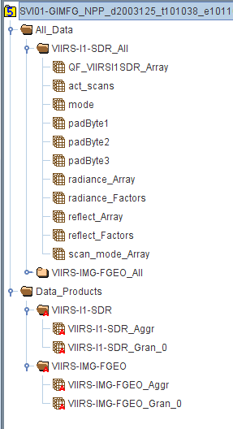
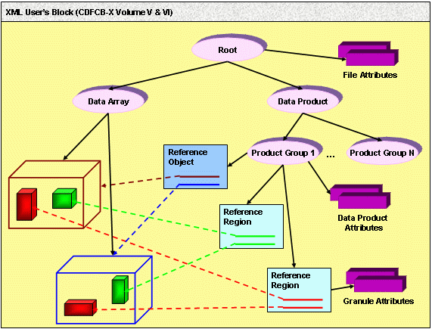
NPOESS Region References
Data products are organized by :
  Reference objects (aggregations).
  Reference regions (granules).

Slide 28
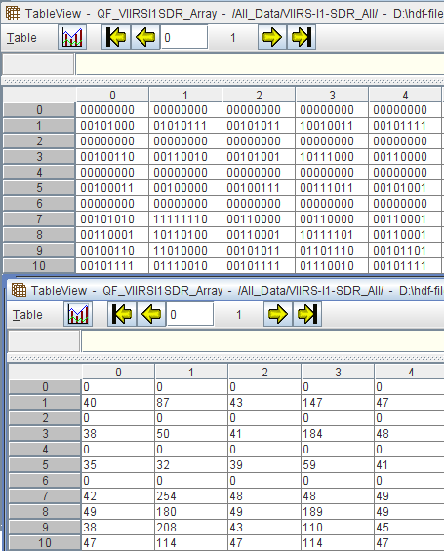
NPOESS Quality Flags
NPOESS quality flags:
  Quality flags are qualifications of one or more consecutive bits in each byte.
  The number of arrays is dependant on the number and size of each data product's quality flag definitions.
  Multiple bit-level flags are packed in a single byte.
  Byte alignment is the same for every quality flag array: first bit is the LSB.

Slide 29
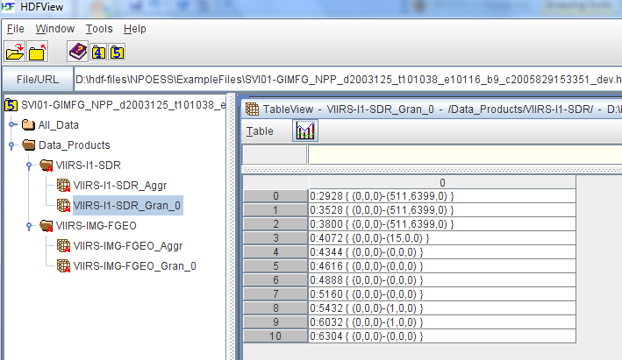
HDFView 2.5 : Region References
HDFView 2.5 or earlier versions:
  Show region references as strings.
  Nothing more, you cannot do anything with the strings.

Slide 30
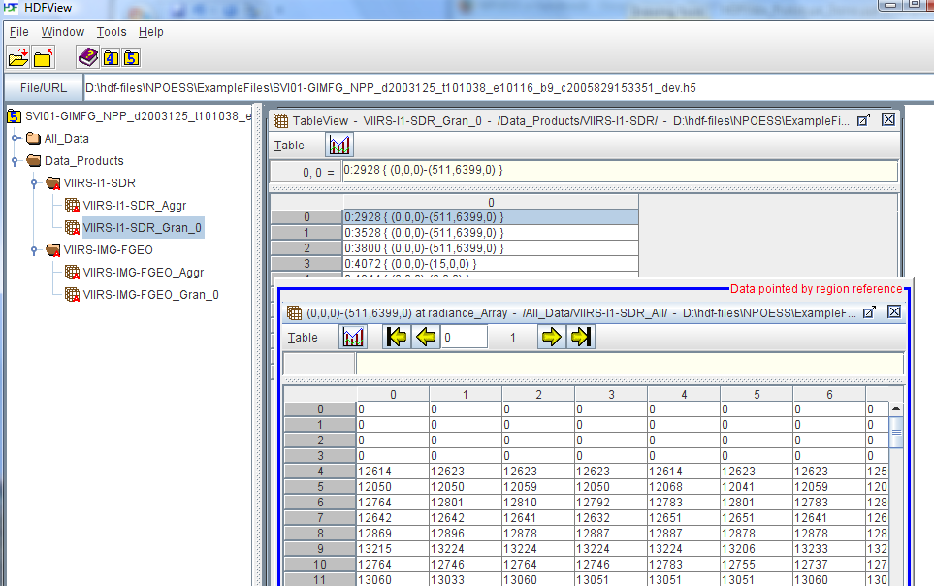
Phase-1 Work: Region References
Show data pointed by a region reference:
  Double click to show data in a separate table.
  Use different border color and text title to distinguish the table.

Slide 31
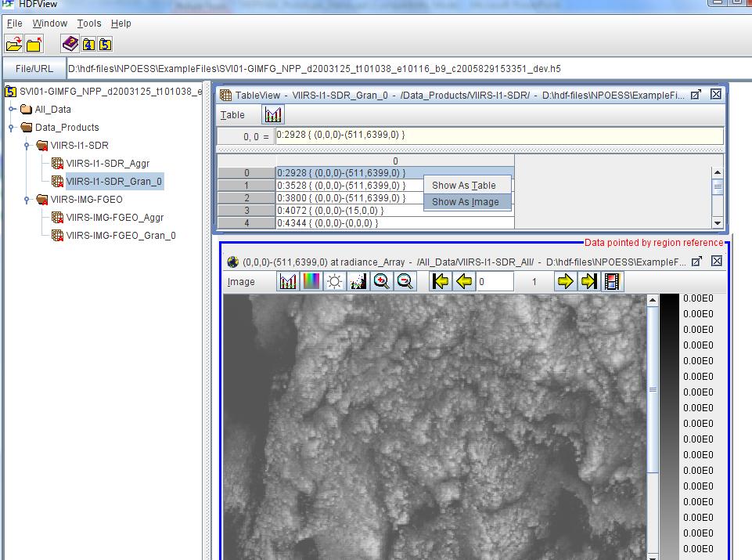
Phase-1 Work: Region References
Options to show data in image or table
  Right click to show a popup window to show data in table or image.

Slide 32
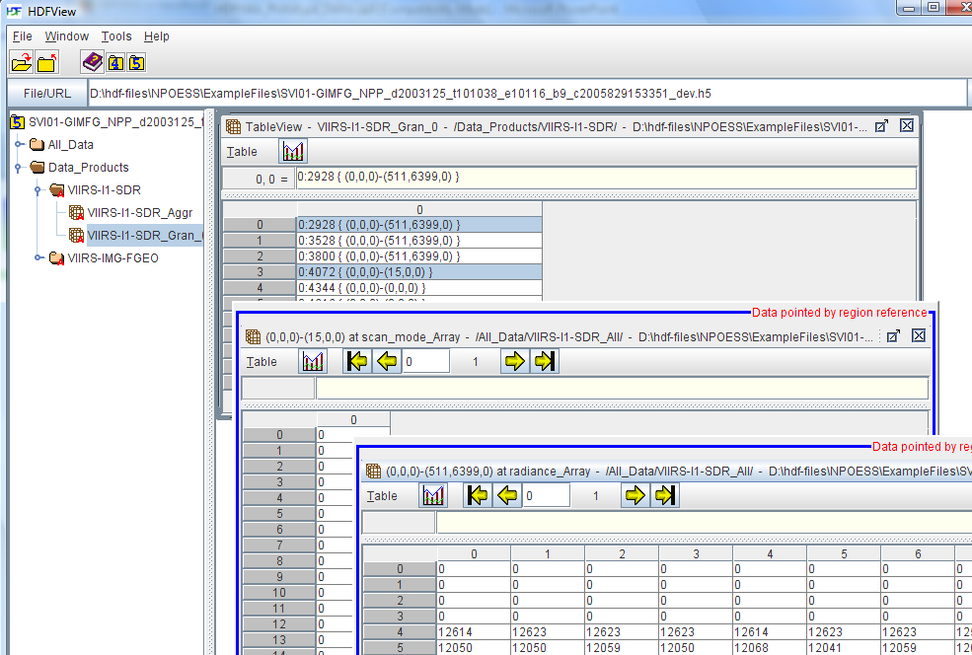
Phase-1 Work: Region References
Open multiple cells at one time:
  Select multiple cells
    Drag mouse to select continuous cells.
    CTR + mouse click to select non-continuous cells.
  Right-mouse click to open selected cell at one time.

Slide 33
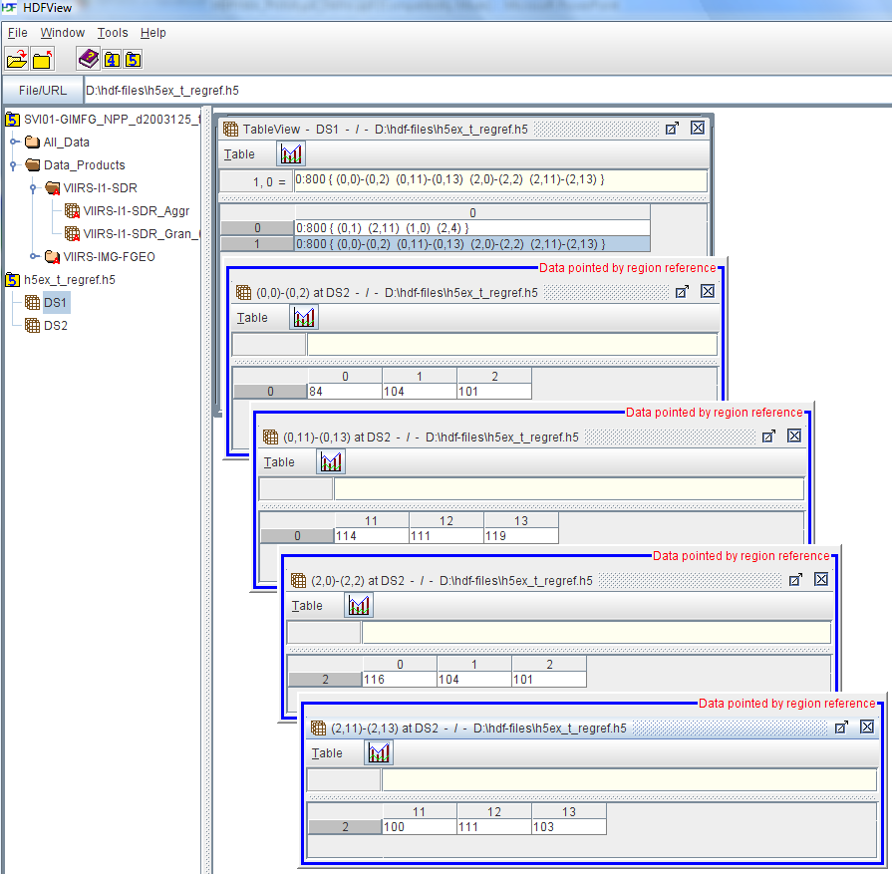
Phase-1 Work: Region References
Show multiple regions pointed by a single reference:
  Separate table to show each region.

Slide 34
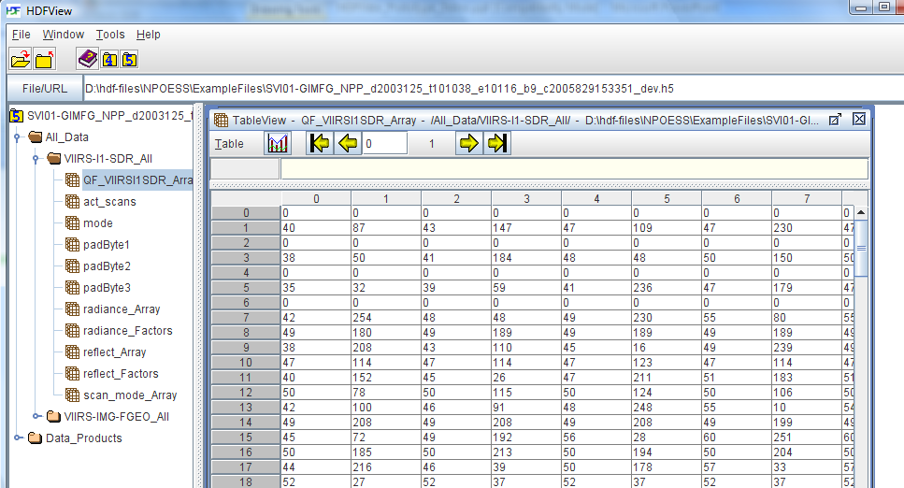
Phase-1 Work: Quality Flags
Use bitmask to show individual quality flags:
  Bitmask only applies to byte data.
  By default, show quality flags as 8-bit decimal integers.

Slide 35
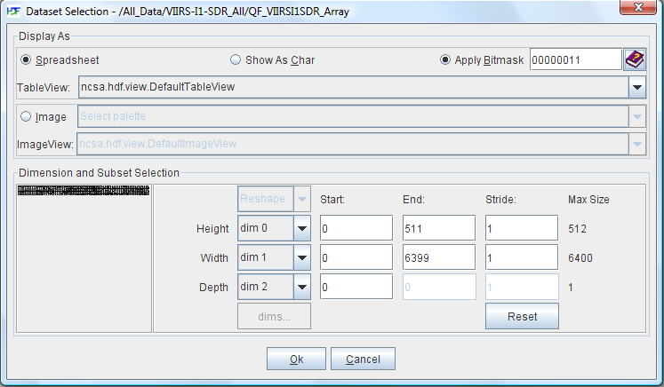
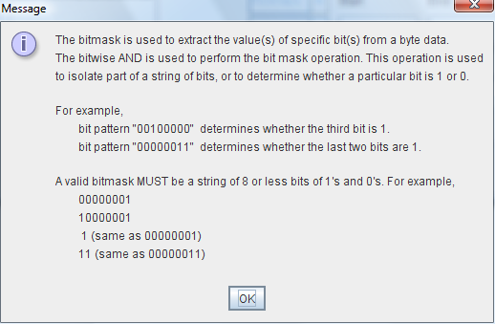
Phase-1 Work: Quality Flags
Use bitmask to extract quality flags:
  Use “Open As” on the dataset of quality flags.
  Enter bitmask, e.g. 00000011.
  Click “Help” icon for help.

Slide 36
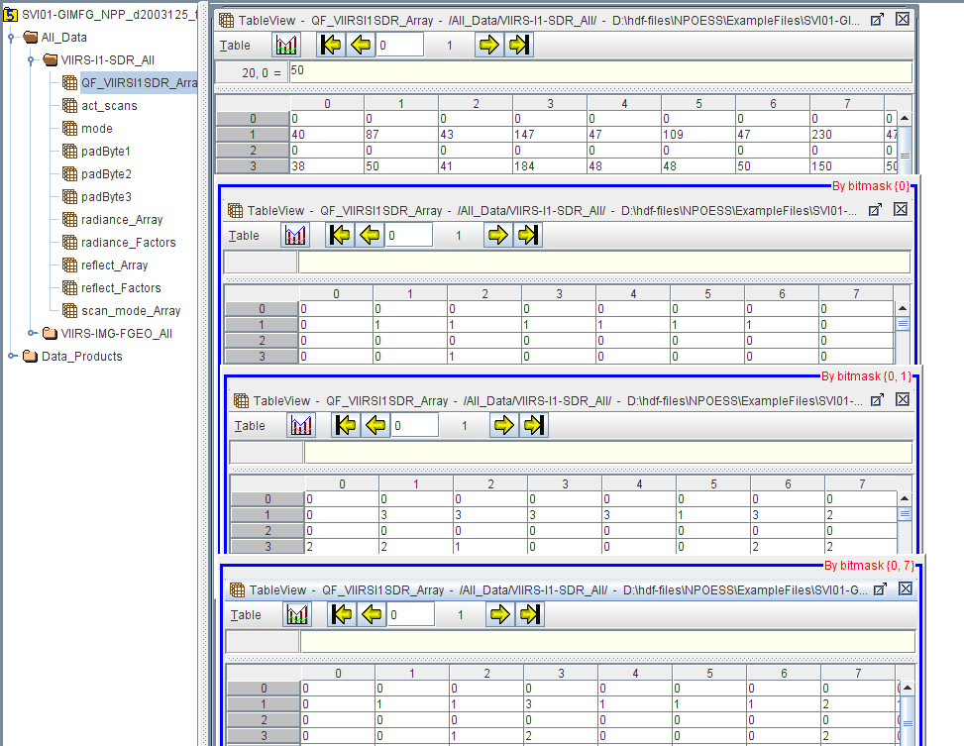
Phase-1 Work: Quality Flags
The mask shown at top-right, e.g. {0, 1}

Slide 37
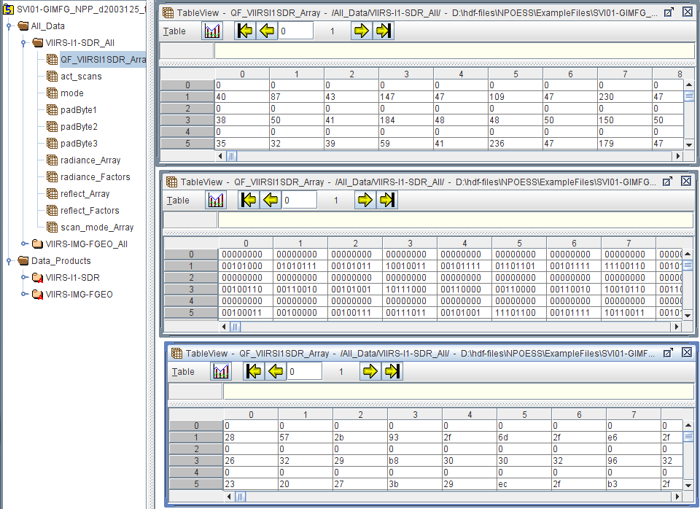
Phase-1 Work: Quality Flags
Data can be displayed in decimal, hexadecimal, or binary.

Slide 38
Phase-1 Work: What Is Left
Open data pointed by object references (aggregation).
Show the name/path of the dataset pointed by a reference.
Add check boxes to select specific bit(s) (or mask).

Slide 39
Phase-2 Work
So far, the right click menu on the object IDs gives me the options: "Show as Table" and "Show as Image". I wonder if the menu could be closer to the right click menu on an All_Data dataset. That is, give me the "Open", "Open as", "Copy", "Save to", "Show Properties" ... but only the ones that makes sense. The "Delete" might not apply since that would alter the structure of the references
Use definition of quality flgas, which are in two separate locations: 1) The Common Data Format Control Book – External (CDFCB-X), Volumes II, III and IV. 2) XML files provided as part of the CDFCB-X delivery.
Apply the structure of the XML to determine whether a field is a packed quality flag byte.
Production quality: testing, documentation, and distribution.

Slide 40
Phase-2 Work: plugin
Two options
  Part of general HDFView
  Separate plugin

Slide 41
Phase-2 Work: plugin
Part of general HDFView
Features for region references and quality flags are part of the HDFView.
Pros:
  No extra work for release and distribution.
Cons:
  Add extra work to maintain the general HDFView (changing/adding NPOESS features will affect the whole HDFView).
  Some features may not be needed for general users.

Slide 42
Phase-2 Work: plugin
Separate plugins
the features will be implemented in separate plugins, which will be added to the general HDFView as requested at runtime.
Pros:
  Modify (add/change features) will not affect the general HDFView.
  Easy to maintain (change/add/delete) NPOESS related features.
Cons:
  Extra work for distributing/maintaining the source and binaries for the plugins.

Slide 43
Phase-2 Work: plugin
To support plugin
Need to extend the NPOESS plugins from default implementation so that changes (new features and bug fixes) in the general HDFView will be automatically applied to the plugins.
Need to redesign/implement the current default implementation of TreeView and TableView. The current default implementation is not extendable. This work will be done in phase-2.
For phase-1 plugin, we will copy the default implementation source code and add the new features to copy.

