Slide 1
Using HDF5 Features with NPOESS data
Performance and File Format Issues
Elena Pourmal
The HDF Group
December 15, 2009

Slide 2
Outline
HDF5 Performance Issues
  Example: Usage of HDF5 chunking with NPOESS/NPP data
  Quick overview of HDF5 chunking
  Possible performance issues for NPOESS data
HDF5 File format
  Backward/forward compatibility issues

Slide 3
  Example
  Usage of Chunking with NPOESS/NPP data

Slide 4
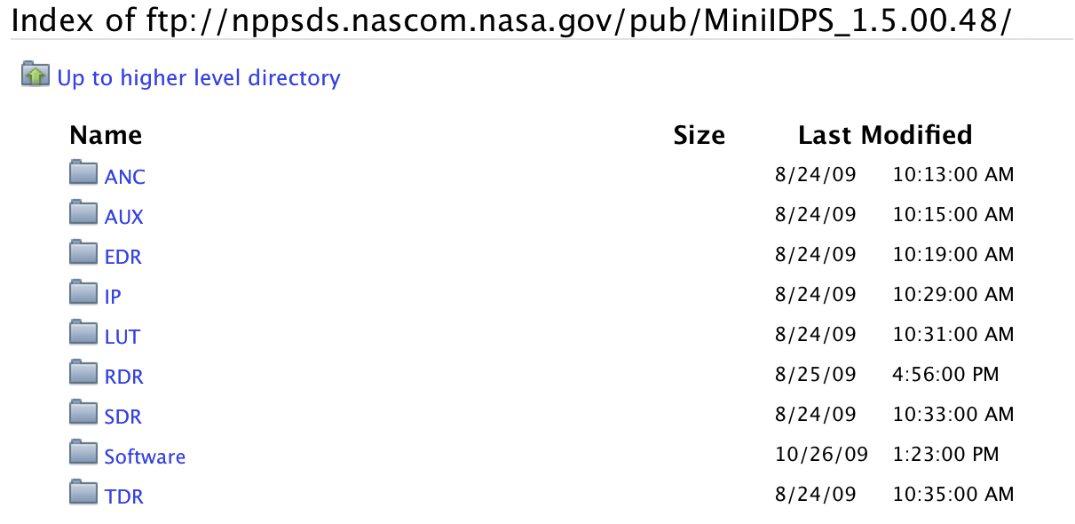
Example NPOESS/NPP Files

Slide 5
Example files
Picked up several files from each folder (first on the list)
Checked datasets properties including chunking parameters for data in
  All_Data folder
  Data_Products folder
Observations:
  All datasets used unlimited dimensions
  Sizes of chunks were set to the sizes of data written; for example, if 2-dim array of 96x400 32-bit floating point numbers was written, chunk size was 96x400
  Datasets in the files from the same folder had the same dimensions, chunk sizes, etc.
  No compression was used
  Chunk sizes varied from few bytes to 40 MB (or even more)
  Question: Is it really necessary to use UD? Chunking, extra data structures, performance issues?

Slide 6
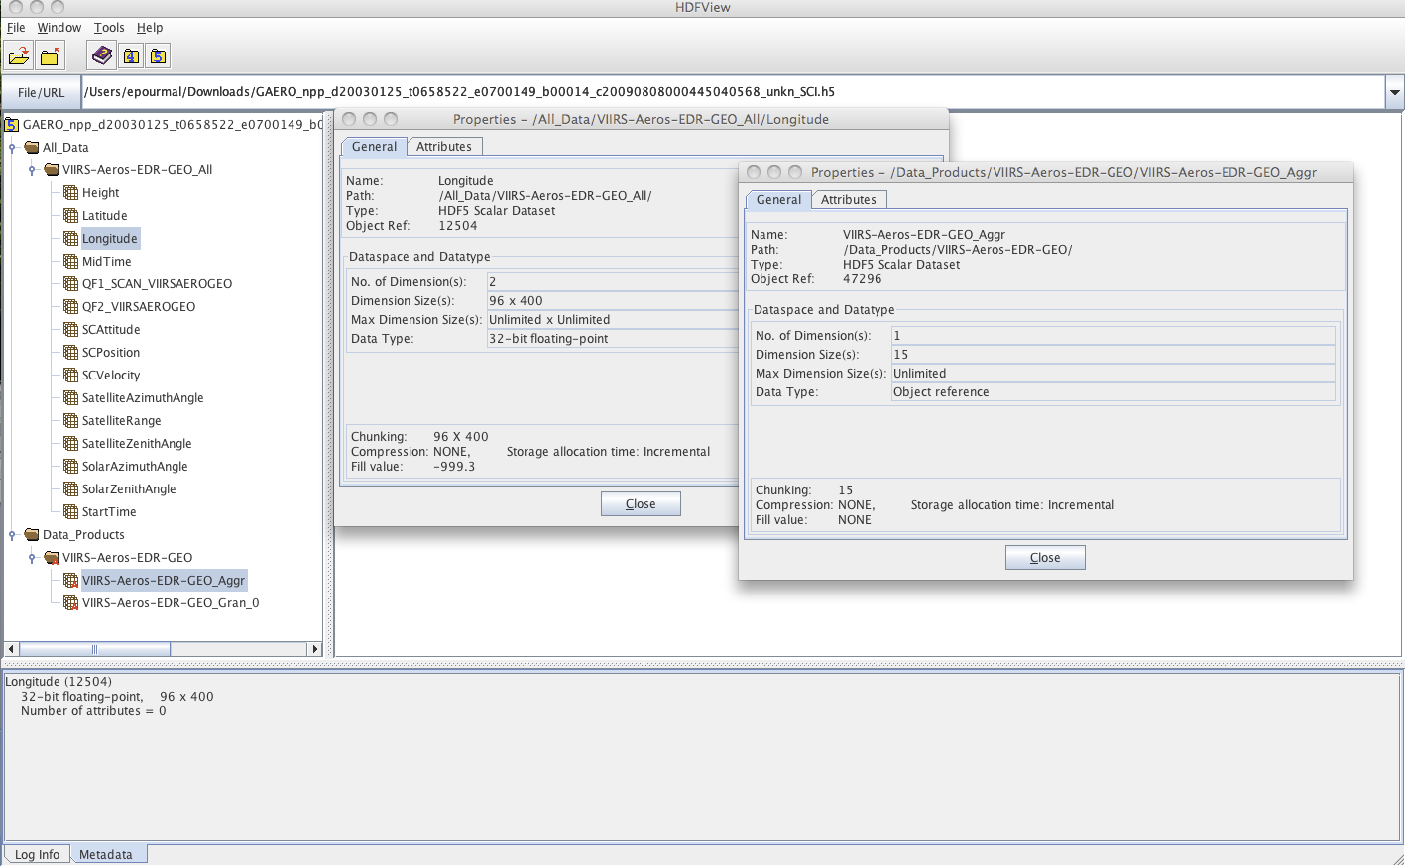
EDR/VIIRS/AERO file

Slide 7
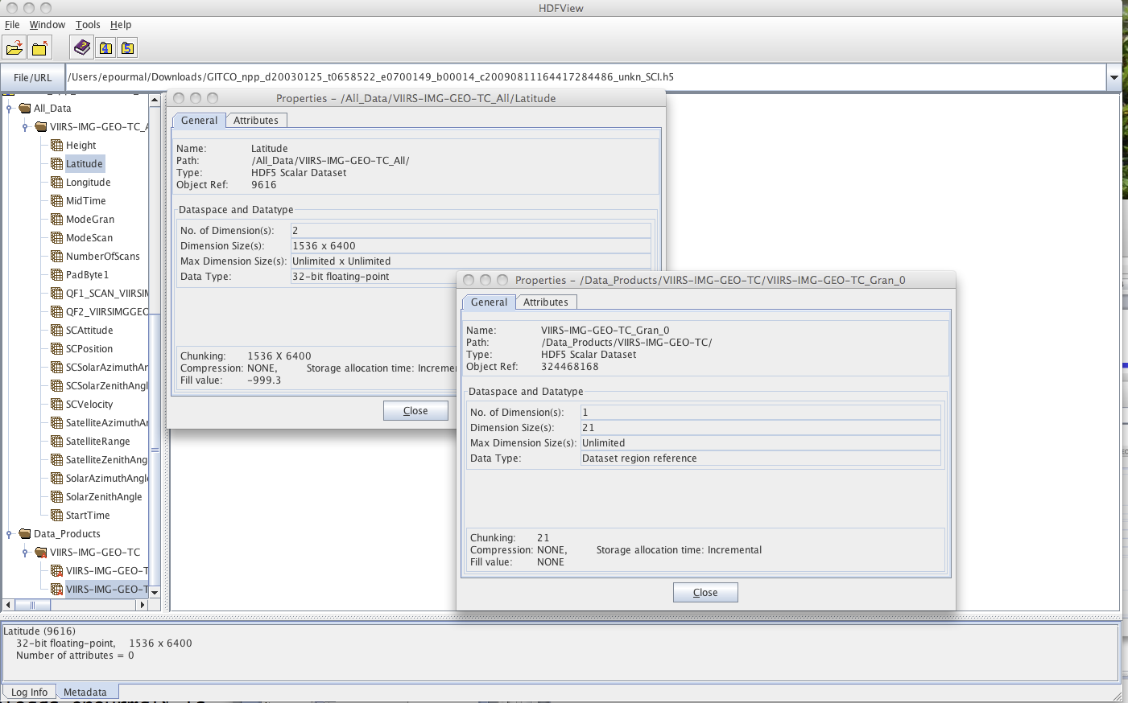
EDR/VIIRS/IMG_TC file

Slide 8
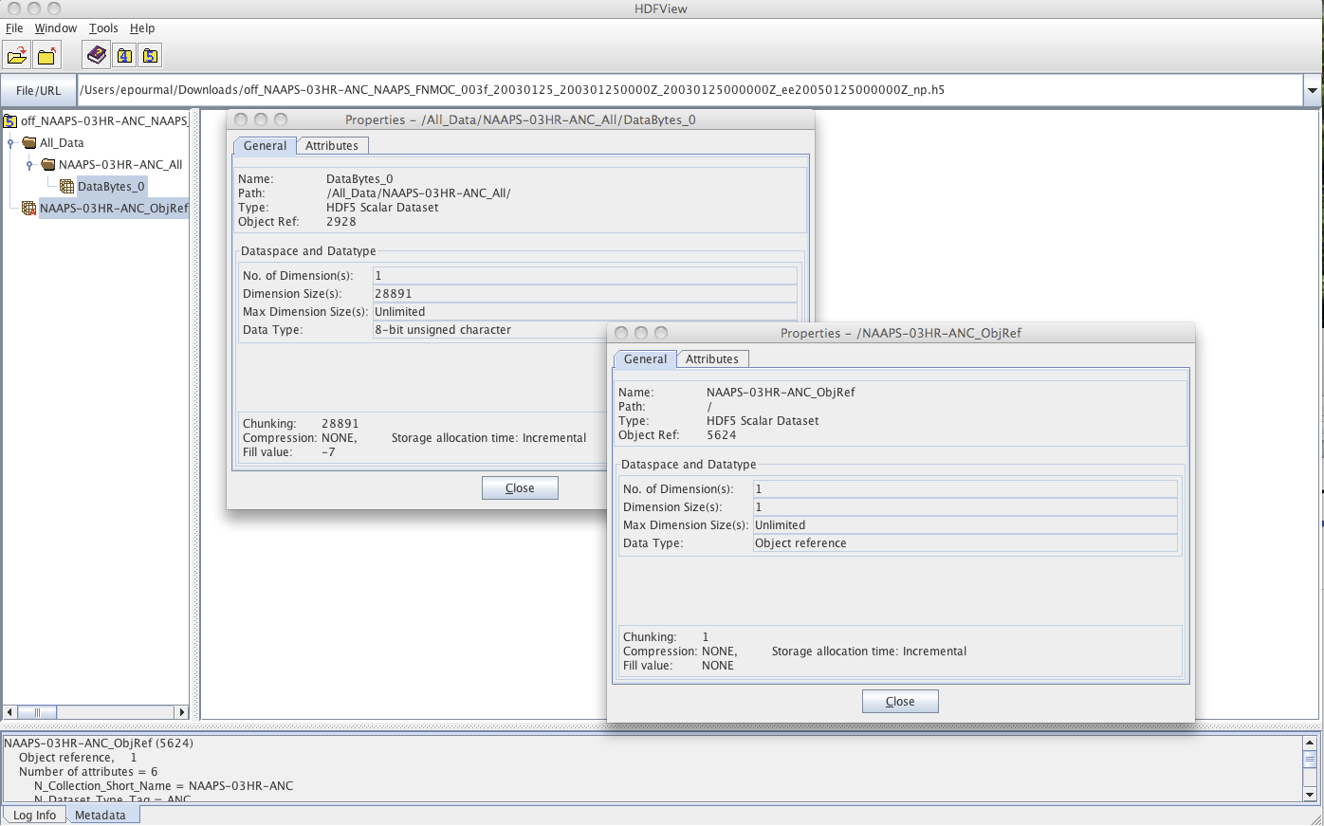
ANC file

Slide 9
HDF5 Chunking

Slide 10
Goal
To help you with understanding of how HDF5 chunking works, so you can efficiently store and retrieve data from HDF5
For more information check
http://www.hdfeos.net/workshops/ws13/agenda.php
Advanced HDF5 Features, Presentation1

Slide 11
HDF5 Dataset
Metadata
Dataset data
Dataspace
Rank
Dimensions
3
Dim_1 = 4
Dim_2 = 5
Dim_3 = 7
Datatype
IEEE 32-bit float
Attributes
Storage info
Time = 32.4
Chunked
Pressure = 987
Compressed
Temp = 56

Slide 12
Contiguous storage layout
Metadata header separate from dataset data
Data stored in one contiguous block in HDF5 file
Application memory
Metadata cache
Dataset header
………….
Dataset data
Datatype
Dataspace
………….
Attributes
…
File
Dataset data

Slide 13
What is HDF5 Chunking?
HDF5 chunking is a way to store data in a file
Data is stored in chunks of predefined size
HDF5 library always writes/reads the whole chunk
Chunked
Contiguous

Slide 14
What is HDF5 Chunking?
Chunks may have different sizes in a file when compression is used
There is an overhead associated with the chunked storage
Application memory
Metadata cache
Dataset data
Dataset header
A
B
C
D
………….
Datatype
Dataspace
………….
Chunk
index
Attributes
…
File
header
Chunk
index
D
A
C
B
Notes:
Emphasize: VL (region) reference takes 12 bytes, i.e. 12 bytes will be read/written + data in a heap size of chunk was 1 fro the last example!

Slide 15
Why HDF5 Chunking?
Chunking is required for several HDF5 features
  Enabling compression and other filters like checksum
  Extendible datasets
If used appropriately, chunking improves partial I/O (see next two slides)
HDF5 library uses caching to improve I/O performance

Slide 16
Accessing data in contiguous dataset
M rows
M seeks are needed to find the starting location of the element. Data is read/written using M disk accesses. Performance may be very bad.

Slide 17
Motivation for chunk storage
M rows
Two seeks are needed to find two chunks. Data is read/written using two disk accesses. For this pattern chunking helps with I/O performance.

Slide 18
Motivation for chunk cache
A
B
H5Dwrite
H5Dwrite
Selection shown is written by two H5Dwrite calls (one for each row).
Chunks A and B are accessed twice (one time for each row). If both chunks fit into cache, only two I/O accesses needed to write the shown selections.
Notes:
Improves performance whenever the same chunks are read or written multiple times

Slide 19
Chunking basics
Things to remember:
  Chunk storage is set up at dataset creation time; chunk storage and sizes of chunks cannot be changed after dataset was created
    What was an appropriate chunk size on writing , may become a problem on reading
  Chunk is the smallest possible I/O unit
    Very small chunk size degrades the performance
Notes:
More data will be written in this case
Ghost zones are filled with fill value unless fill value is disabled

Slide 20
Chunking cache
Things to remember:
  Chunk cache size should be set up appropriately
  Default size is 1MB (probably too small)
  Cache is set up for each dataset
  Size of the cache may be set up per file or per dataset
  Chunk cache size should be large enough to hold all chunks in selection
Notes:
More data will be written in this case
Ghost zones are filled with fill value unless fill value is disabled

Slide 21
HDF5 Chunk Cache and its Impact on
Performance

Slide 22
Accessing EDR/VIIRS/IMG_TC file
Example: “Latitude” dataset read
Chunk size is ~ 40MB
Performance depends on the size of the cache and access pattern

Slide 23
Accessing EDR/VIIRS/IMG_TC file
Case 1: Default cache size 1MB is used
  Reading the whole dataset
    Good performance (one 40MB read)
  Sub-setting:
    Since compression is not used, library reads directly from the file
    Reading dataset by row will require 1536 disk accesses
    Reading dataset by column will require 1536x6400 disk accesses
    Performance is the same as for contiguous storage

Slide 24
Accessing EDR/VIIRS/IMG_TC file
1536 rows
Data is read directly from the file.
1536 seeks are needed to find the starting location of the element. Data is read using 1536 disk accesses.

Slide 25
Accessing EDR/VIIRS/IMG_TC file
Case 2: Cache size 40MB is used
  Reading the whole dataset
    Good performance (one 40MB read)
  Sub-setting:
    The whole chunk is read into cache
    Both reads by row or column give good performance

Slide 26
Accessing EDR/VIIRS/IMG_TC file
memcpy
Chunk in memory
Application buffer
1 read from disk is needed to read the chunk
Column is copied from cache to an application buffer
Note on writing: Twice as much data (first row with whole chunk, then directly to the file since no compression is enabled

Slide 27
Possible performance issues for NPOESS data

Slide 28
Accessing EDR/VIIRS/IMG_TC file
Case 3: Example: h5repack is used to compress dataset “Latitude”
h5repack uses default chunk cache size 1 MB
The whole dataset doesn’t fit into internal h5repack buffer
h5repack writes the dataset by hyperslabs (160 rows at a time ~1MB , 40 hyperslabs total)
Performance will be poor
Why?

Slide 29
Writing a compressed dataset
  For each hyperslab (40 total)
      Fill chunk with the first 160 rows, compress, write to a file
      For each hyperslab (39 hyperslabs)
        Read chunk back, uncompress
        Fill chunk with the hyperslab
        Compress
        Write chunk to a file
      End For
  End For
  Total disk accesses 40 x(1+2x39)= 3160
  Total data written and read ? ~80 x (size of compressed chunk )

Slide 30
Writing a compressed dataset
  Note: HDF5 tools should detect such behavior and increase chunk cache size (on our to-do list)
  NPOESS applications may face the same problem

Slide 31
Backward/forward compatibility issues

Slide 32
HDF5 File Format Versioning
There is no HDF5 file format version number
  Micro-versioning: each object (header message) and structure within an HDF5 file is versioned
  Updated “File Format Specification” is available with every public release
  There is no way to find what version of the library created or modified a particular file
  Why did we choose such approach?

Slide 33
HDF5 File Format Versioning
Maximum file format compatibility principle
  By default the HDF5 files are written with the earliest version of file format that describes information, rather than always using the latest version possible.
  Assures best forward compatibility with the older versions (objects in new files can be read with old libraries if that object is “known” to the old libraries)

Slide 34
HDF5 File Format Versioning
Maximum file format compatibility principle
  Example: Datatype header message
    Versions 0, 1 and 2
      Version 0 used by the latest library for datatype messages in all situations where are no array datatypes used
      Version 1 (introduced in 1.4.0) used by 1.6.10 and earlier versions of the library to encode compound datatypes with explicit array fields.
      Version 2 is used for 1.8.0 and later if requested by setting special flag (latest file format); helps to reduce overhead in describing complex datatypes
      By default 1.8.* writes compound data compatible with 1.4.0 – 1.6.X libraries
      If feature is requested, compound data created by 1.8.0 will not readable by earlier versions

Slide 35
HDF5 Forward Compatibility
Forward compatibility or what do we promise (file format)
  Forward compatibility is most difficult to achieve and maintain
  Achieved by using micro-versioning and “maximum compatibility” principle
  Old versions of the library will read all objects in a file created by a newer library if objects are known to the old library
    Example: 1.6.5 library will read a group in a file created by 1.8.0 version unless new 1.8.0 features are used (e.g. external links or compact groups)

Slide 36
HDF5 Forward Compatibility
Forward compatibility or what do we promise (APIs)
  Application written to work with an older version will compile, link and run as expected with a newer version
    APIs are not deleted or changed (if possible)
    APIs do not change behavior (if possible)
    May require configuration flag –enable–hdf5v1_Y to enable old APIs, data structures and behavior
  Drawbacks
    Have to keep old APIs until another major release or indefinitely
    Cannot make new features to be enabled by default
      H5Gcreate will create “old” style groups in 1.8.0
      H5Gcreate2 will create “new” groups (supports creation order, compact storage, improved heap structure, low and controlled overhead, etc.)

Slide 37
HDF5 Backward Compatibility
Backward compatibility or what do we promise
  File Format
    Newer version of the library will always read files created with an older version
    Aside: HDF4 can read HDF4 files created in 1988 ☺
  Library APIs
    Application that doesn’t use new features will compile and link with the older library

Slide 38
Questions?

